Slide 1

Thinking about EdTech in Education
Vincent Quah
Regional Director
Microsoft APAC
Notes:
Welcome

Slide 2

Empowering every institution, educator and learner to achieve more

Slide 3








The pace of change is accelerating.
Rapid digital adoption
Industrial Revolution
Electricity
Moon Landing
World Wide Web
Human Genome Sequenced
4th Industrial Revolution
Global pandemic
120 yrs.
90 yrs.
20 yrs.
15 yrs.
10 yrs.
5 yrs.
Notes:
The pace at which technology and innovation advances is constantly accelerating. The time span between disruptive historical events is getting smaller and smaller. The 4th Industrial Revolution (AI, machine learning, nanotechnology, etc.) brought advanced technology blurring lines between the physical, digital, and biological thus creating a platform for all aspects of our lives to become digitized. Through the pandemic, we started to witness how this can happen so quickly in our personal and professional lives.

Slide 4

“We have seen two years’ worth of digital transformation in two months.”
Satya Nadella,
April 2020
Notes:
Our own Satya Nadella said it best. “We have seen two years’ worth of digital transformation in two months”.
According to a new McKinsey Global Survey of executives, the COVID-19 crisis has brought about years of change in the way companies in all sectors and regions do business. Companies have accelerated the digitization of customer and supply-chain interactions and internal operations by three to four years.
COVID-19 digital transformation & technology | McKinsey

Slide 5


Digital from nice-to-have to must-have.
Pre-COVID
Post-COVID
Face-to-face is the most effective method
Face-to-face is one method
Face-to-face is required
Digital can be more effective
Digital = Primarily video
Digital = Human experiences
Digital is a ‘nice-to-have’
Digital is a ‘must-have’
Notes:
Through this experience we have learned to shift how we operate our lives. How we work, how we learn, and how we even buy groceries. We are in the midst of a massive global social experiment. The very nature of our regular day-to-day, face-to-face training, meetings and work is being challenged at a fundamental level.
Here are some examples of that mindset shift.
Pre-COVID: Face-to-face is the most effective method of training to Post-COVID: Face-to-face is one method for training that can be used alongside other effective experiences
Pre-COVID: Digital is a ‘nice-to-have’ as part of a blended experience to Post-COVID: Digital is a ‘must-have’ and can make the learning experience even more effective than just in person
Pre-COVID: Digital = Primarily video with quizzes or print-outs (MOOC-style to Post-COVID: Digital = Human experiences that are social and participatory
Pre-COVID: Face-to-face is required for skills building and any applied learning to Post-Covid: Digital can be more effective for practice-based, applied skills development

Slide 6





An Opportunity for Education
Blended Learning
Digital Curriculum
Advanced Analytics
Skilled Workforce
Notes:
What does this mean for education? It’s not much different than what the private sector has experienced. Education systems and institutions must also fundamentally change the way they operationalize teaching and learning and prepare students for a digital and constantly changing world.
Many had embraced the opportunity to transform their systems years before the pandemic hit, and the impact to them was minimized. Others were hit harder. What is important now is the realization that this is no longer just an opportunity but an imperative. There is no more “business as usual” as we look ahead to the future of education and what that means.

Slide 7







Transformation in action
Ministry of Education Republic of Azerbaijan
Using data to provide personalized learning for all
Engaging preschoolers with creative and fun learning opportunities
Generating actionable insights to support equitable outcomes
Embracing data for teaching and learning outcomes
Providing ongoing learning experiences for all students
Prioritizing student well-being for better learning
Notes:
Here are just a few examples of the many stories we received about schools doing amazing things to keep education going. I won’t take the time to go into the specifics, but just to highlight a few.

Slide 8

How do we build on this
MOMENTUM?
Notes:
So the question I would like us to ask ourselves is how do we build on this momentum? There is no question the last couple years has been incredibly difficult. But how do we take a growth mindset and use this adversity as a catalyst for creativity and innovation.

Slide 9




What innovative schools are planning worldwide
77%
77%
74%
72%
69%
Increase tech professional development
Develop “catch up” plans
Leverage data for insights
Continue blended learning
Develop social emotional skills
Survey results from 62 Microsoft Showcase Schools
Microsoft Showcase School Program
aka.ms/scsp
Notes:
This is what we are hearing from our Showcase School Community. The canary and the coal mine, someone sees something I don't.
Include a point of view for each survey result…

Slide 10

Pandemic learning loss.
63%
Post-pandemic
53%
Pre-pandemic
Global share of 10-year-olds that cannot read a simple paragraph.
Some areas like Sub-Saharan Africa now reaching more than 90%
Equitable education in a post-pandemic world
The Education World Forum

Slide 11

Learning loss = earning loss.
10 trillion
Projected losses in terms of affected children’s future earnings.
Simulating the Potential Impacts of the COVID-19 School Closures on Schooling and Learning Outcomes: A set of Global Estimates
The World Bank

Slide 12

The skills crisis.
825 million
By 2030 more than 825 million students will not have the skills needed to support lifelong learning and employment.
Adolescent education and skills
UNICEF
Notes:
Adolescent education and skills | UNICEF

Slide 13

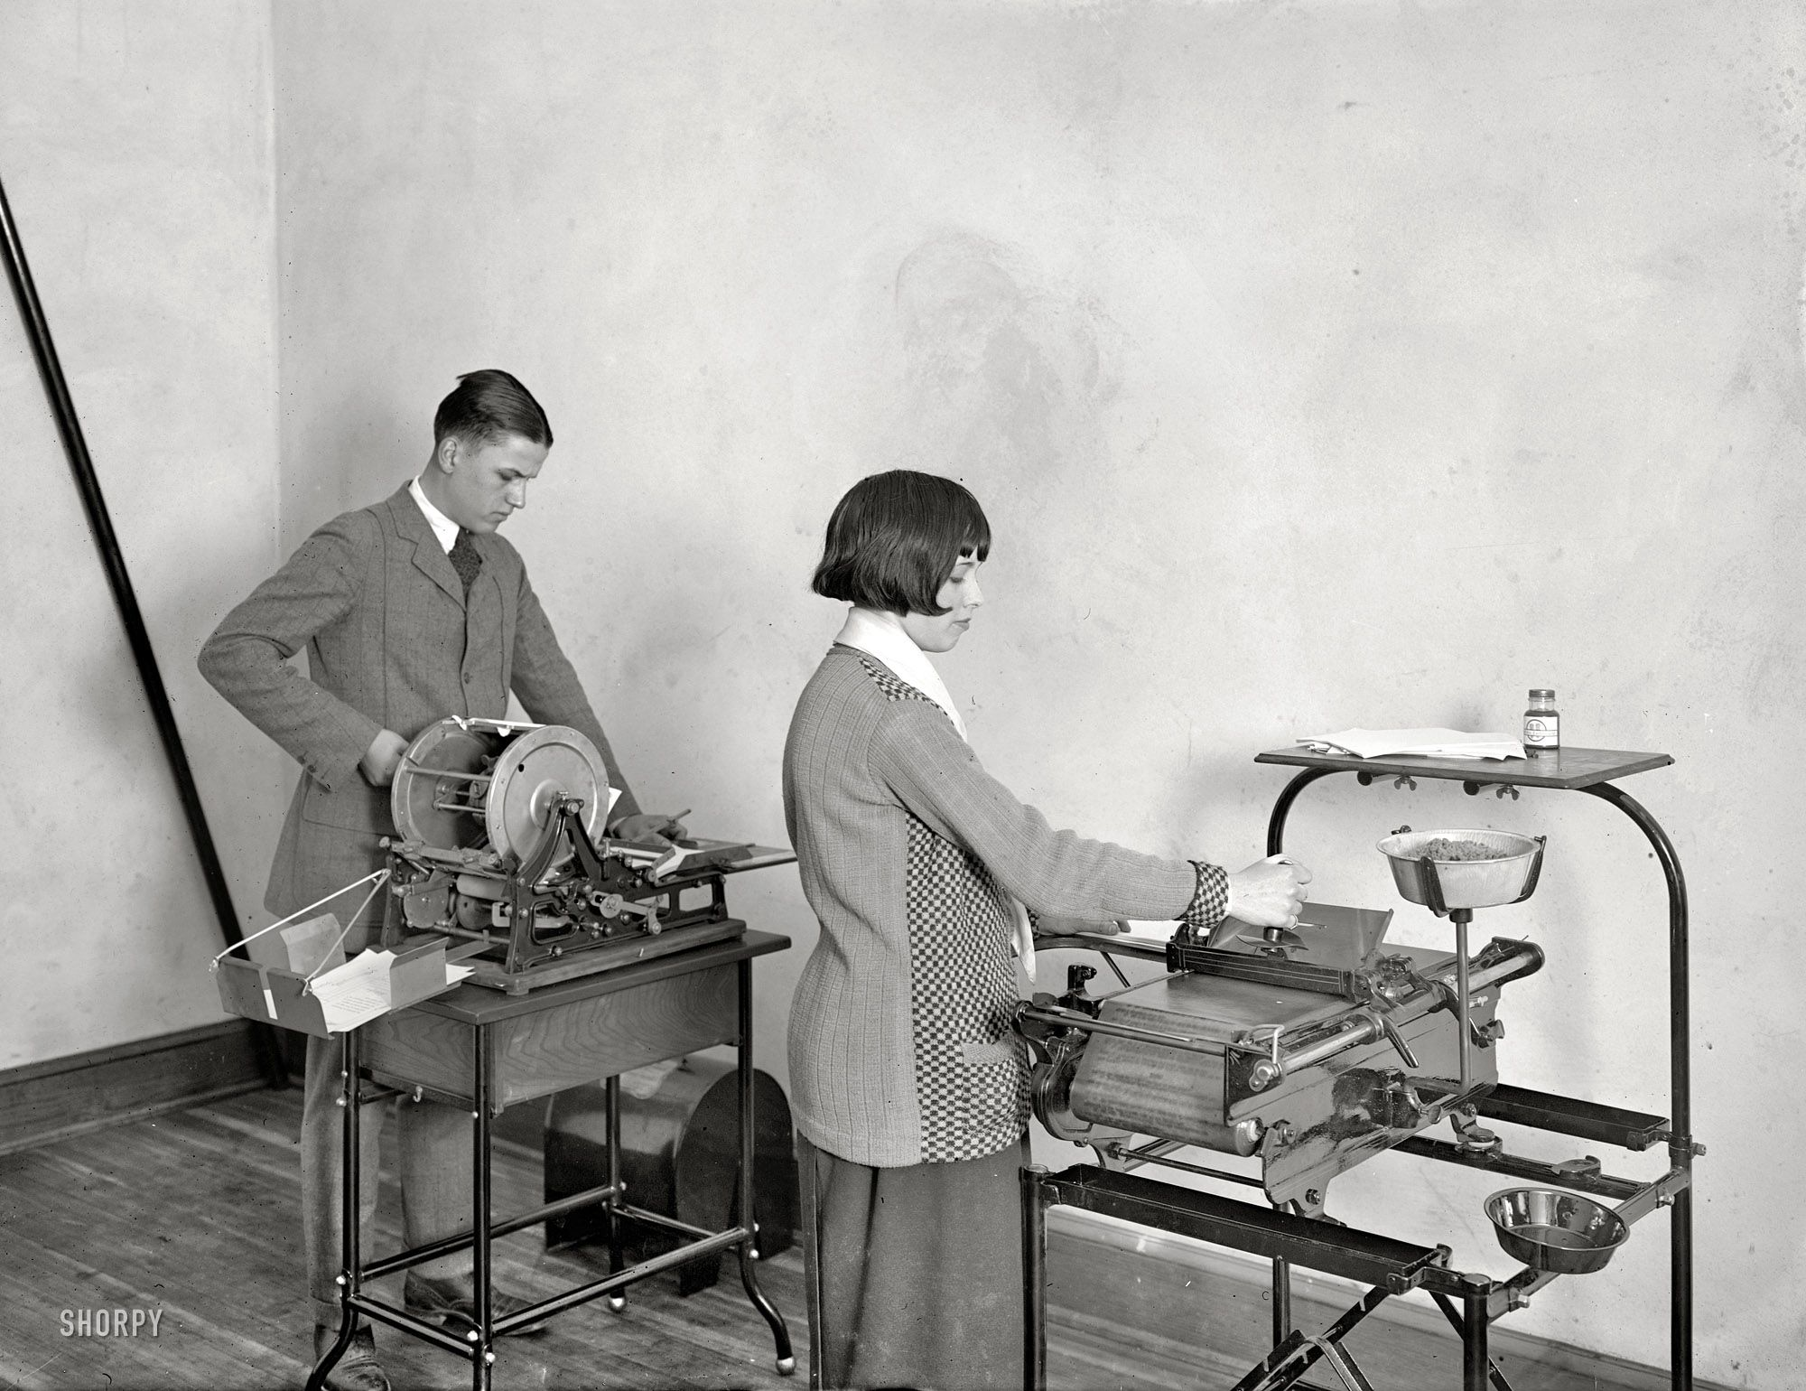

Adversity as a catalyst for creativity
The Ambulance
The Printing press
The Blood Bank
Napoleonic Wars
Second Plague Pandemic
World War I
Notes:
We have some great examples of this from the past that we can reflect on for inspiration. It was a fun exercise to look for these examples and think back to the many hardships from the past, and how so many things we still use and depend on today were born from that. Here are just a few examples…
The Ambulance:
One of the first truly global conflicts, the Napoleonic Wars were fought across all inhabited continents. A slew of innovations came about as a consequence of the hostilities, which raged from 1793 to 1815. They include the world's first ambulances. The horse-drawn vehicles were the brainchild of leading French surgeon Baron Dominique Jean Larrey, who also introduced triage and the mobile army surgical hospital
The Printing Press
The second plague pandemic began in 1346 with the Black Death, which claimed 200 million lives in Eurasia and Africa. Surviving members of the lower classes became better off as a result and an unprecedented number of people were able to afford books. The outbreak also massively reduced the population of monks who could transcribe manuscripts by hand, which resulted in a surplus of rags, making paper cheaper, and led to the creation of oil-based inks. These factors fueled the development of the printing press, which was invented around 1440.
The Blood Bank
Towards the end of the First World War the discovery of blood types and improved refrigeration methods enabled the long-term storage of blood and brought transfusions to the masses, something that wasn't possible before the conflict. In fact, US Army doctor Captain Oswald Hope Robertson set up the world's first blood bank in 1917 on the Western Front.

Slide 14

Quotes about online learning
“Online learning gave so much opportunity to the shy students that rarely talk and engage in classroom activities.”
“As a tech-specialist and coach, the biggest positive was the increased desire in teachers to try innovative ways to teach.“
“We really saw how adaptable our students were, how resilient to change. Even the 6- to 8-year-olds that I work with embraced new tools!”
“Technology was proven to be an enabler in making learning personalized and student-centered.”

Slide 15

It’s about
PEOPLE
Notes:
I think a common thread you can see from the past is it’s all about people. People must be involved at every stage: discovery, development, execution, and adoption. Effective digital transformation is people-led and technology-enabled. It must prioritize people rather than just focus on technology alone.

Slide 16

Empower every person and organization to do more.
Notes:
And that’s Microsoft’s mission: to empower every person and every organization on the planet to achieve more. It’s people-centric and technology is the enabler. We want to use the power of AI and Computing to make a difference to individuals and their communities with a diverse range of skills, cultures and backgrounds.

Slide 17


Covering all levels of the system.
From Classroom
To Career
Notes:
Microsoft uniquely sees the whole picture and designs solutions with the connection points in mind. We see individuals as lifelong learners and want to ensure our solutions have connectivity throughout the student journey.

Slide 18

Now more than ever, it is critical to think about the entire process.

Slide 19
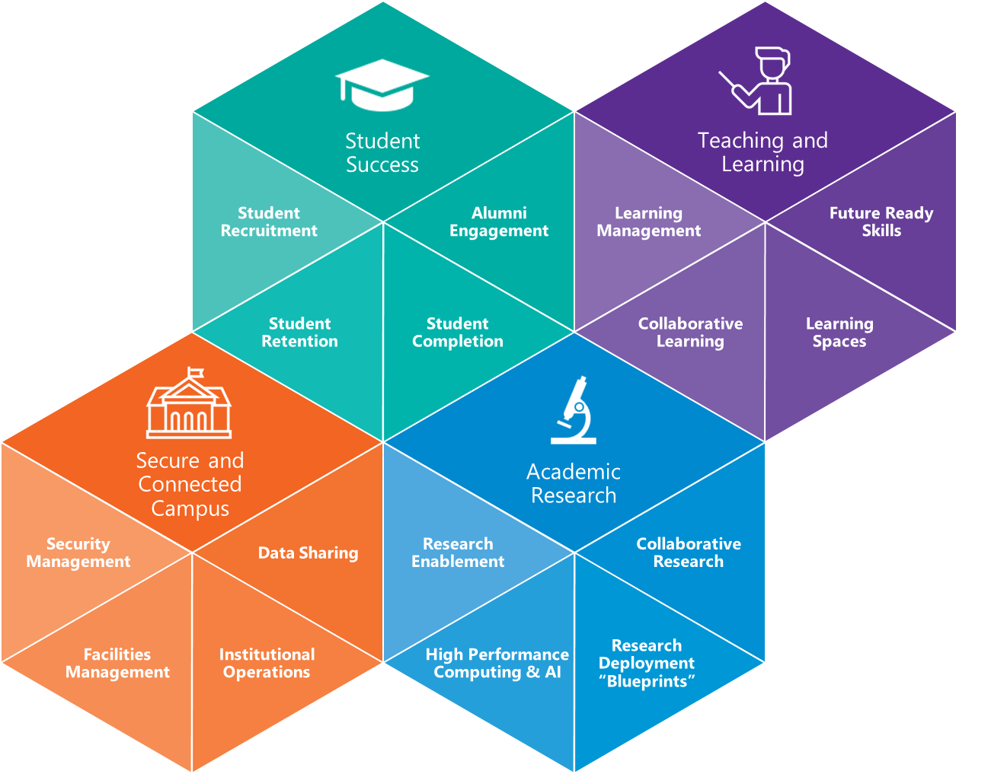
Exam Exceptions
Study room bookings
Assessment results collection
Training menu
Timetabling
Student enquiries
Councillor appointment
Student attendance
The Microsoft Education Transformation Framework provides practical advice to develop a strategy for digital
transformation; supporting new
approaches to:
Manage student success
Modernize teaching and learning
Empower research
Provide efficient and effective physical
and digital infrastructure
Room Bookings
Asset Management
Visitor Sign-in
Workers' compensation
Campus issue logging
RPA surround
Research Grant Management
Research Asset tracking – Check-in/Check-Out
Purchase requisitions?
Notes:
The Microsoft Education Transformation Framework shows you how emerging technologies, such as artificial intelligence, support new approaches to managing student success; modernizing teaching and learning, empowering research; and building efficient and effective physical and digital infrastructure.
It provides practical advice to help you develop a strategy for digital transformation with a holistic, long-term view implemented in discrete phases that you can begin today.

Slide 20




Reality Check for Education Data Analytics & AI
Aspiration
but…
Reality
Inclusion and Fairness
Siloed Data
Cost of data management
Personalize Learning
Data security and privacy
Difficult to extract insights
Improved learning outcomes
Insights not actionable
Poor or no Governance
Reliability and Safety
Poor User Adoption
Transparency & Accountability
Ethical AI concerns
Do more with less
Lack of data & AI technical skills
Notes:
What customers what and are trying to do, but…
The realty is

Slide 21

Flagging students needing recovery learning
“We are trying to always use the data as a flashlight, rather than a hammer. So it's not about competition or comparison, but rather what can it tell us so that we know how to improve. ”
- Marnie Wilson: Data Literacy Coordinator
Louis Riel School Division
Notes:
With learning happening at home. Louis Riel realized they needed to target students that need recovery learning when returning in the fall.

Slide 22

Using data to provide personalized learning for all
By using Open Education Analytics (OEA), the Ministry could analyze the quality of the teaching and learning experience and make data-driven decisions.
Ministry of Education Republic of Azerbaijan
Notes:
Help all Azerbaijani students receive equal, personalized, and industry-relevant education opportunities, using digital tools to prepare learners for future careers and changing teachers’ mindsets as to how they teach.
By using Open Education Analytics (OEA), the Ministry could analyze the quality of the teaching and learning experience and make data-driven decisions.
Now, they monitor how multiple teacher-related variables (training, age, background, teaching practices), student-related variables (attendance, gender) and school-related variables (region, infrastructure) relate and impact learning outcomes.

Slide 23
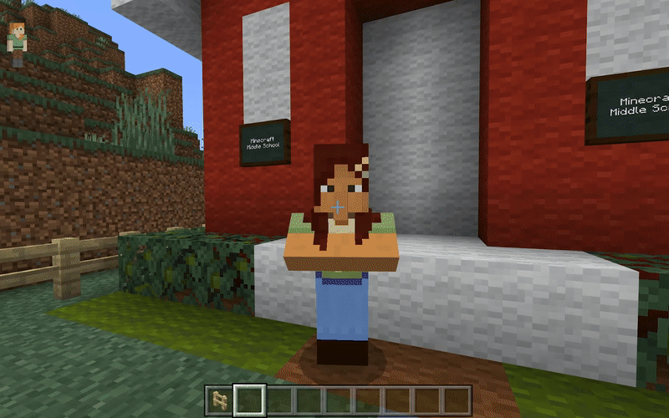
Minecraft + Immersive Reader

Slide 24
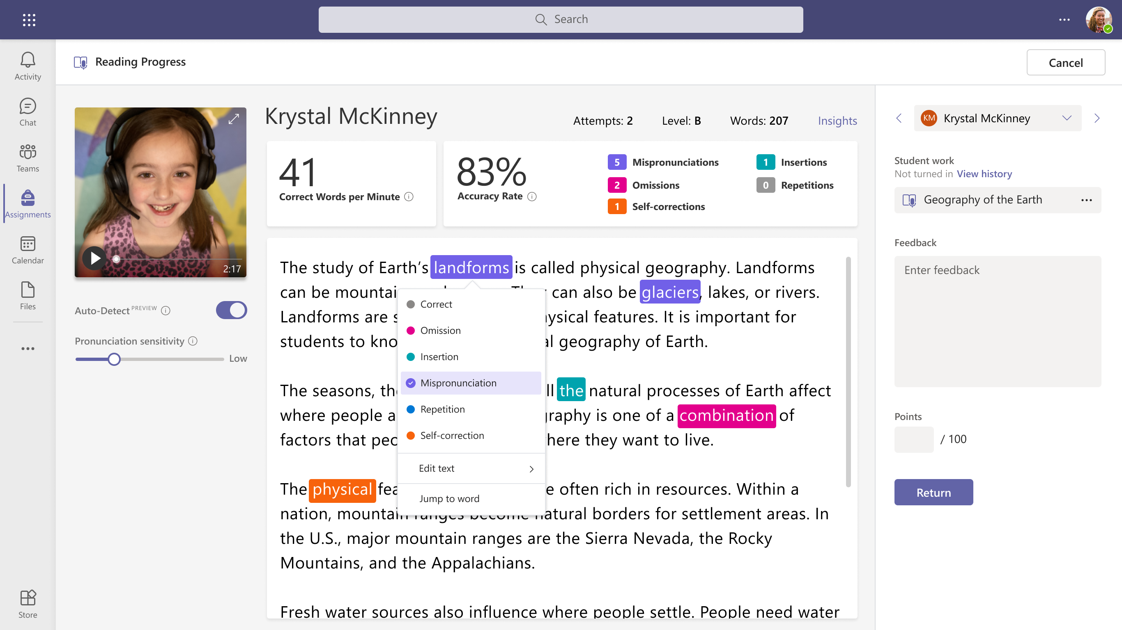

Demo

Slide 25
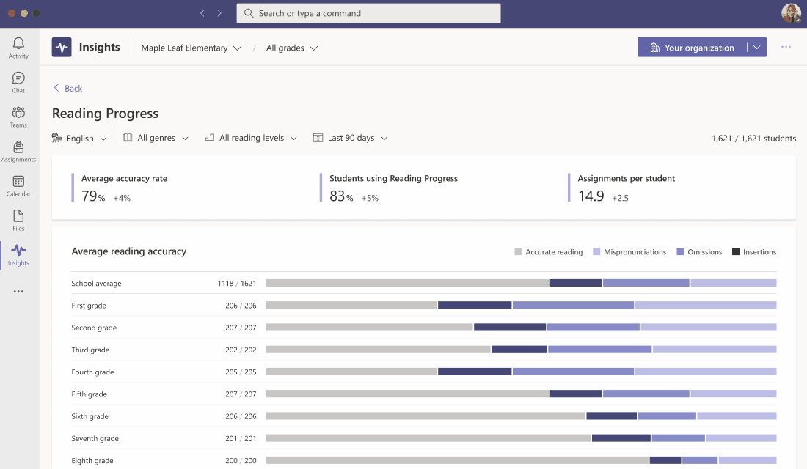
Track reading fluency in your school or district
Reading Progress
Notes:
Educators put their collected reading data to work in Education Insights. Check on their students with at-a-glance views for accuracy rate, most challenging words, and words per minute data. Reading Progress works with Education Insights to support them in differentiating instruction and documenting progress - so they can make the most of time with your students and demonstrate your impact as an educator.
The reports can be filtered for every level of the organization, from the educator’s perspective in a single class, the subject or grade/year level, through to the school, district, or institution.

Slide 26




Drive a positive school climate with Reflect
Sample the school climate
Understand which groups need more support
Students
Educators
How do you feel everyday in school?
How do you want to feel?
Build intervention programs based on data-driven findings
Guardians
Educational leaders
Share best practices
Notes:
Insights enables you to sample the school climate based on its smart logic.
You’ll understand which groups need more support.
Build intervention programs based on data-driven findings.
For example, maybe a gifted student feels lonely and want to feel part of the class, you can develop an intervention plan to support them and then tracl the impact in the emotional climate report.
Share best practices – if you see that a specific grade level of class performs well, you can encourage their educator to share what works for them.

Slide 27
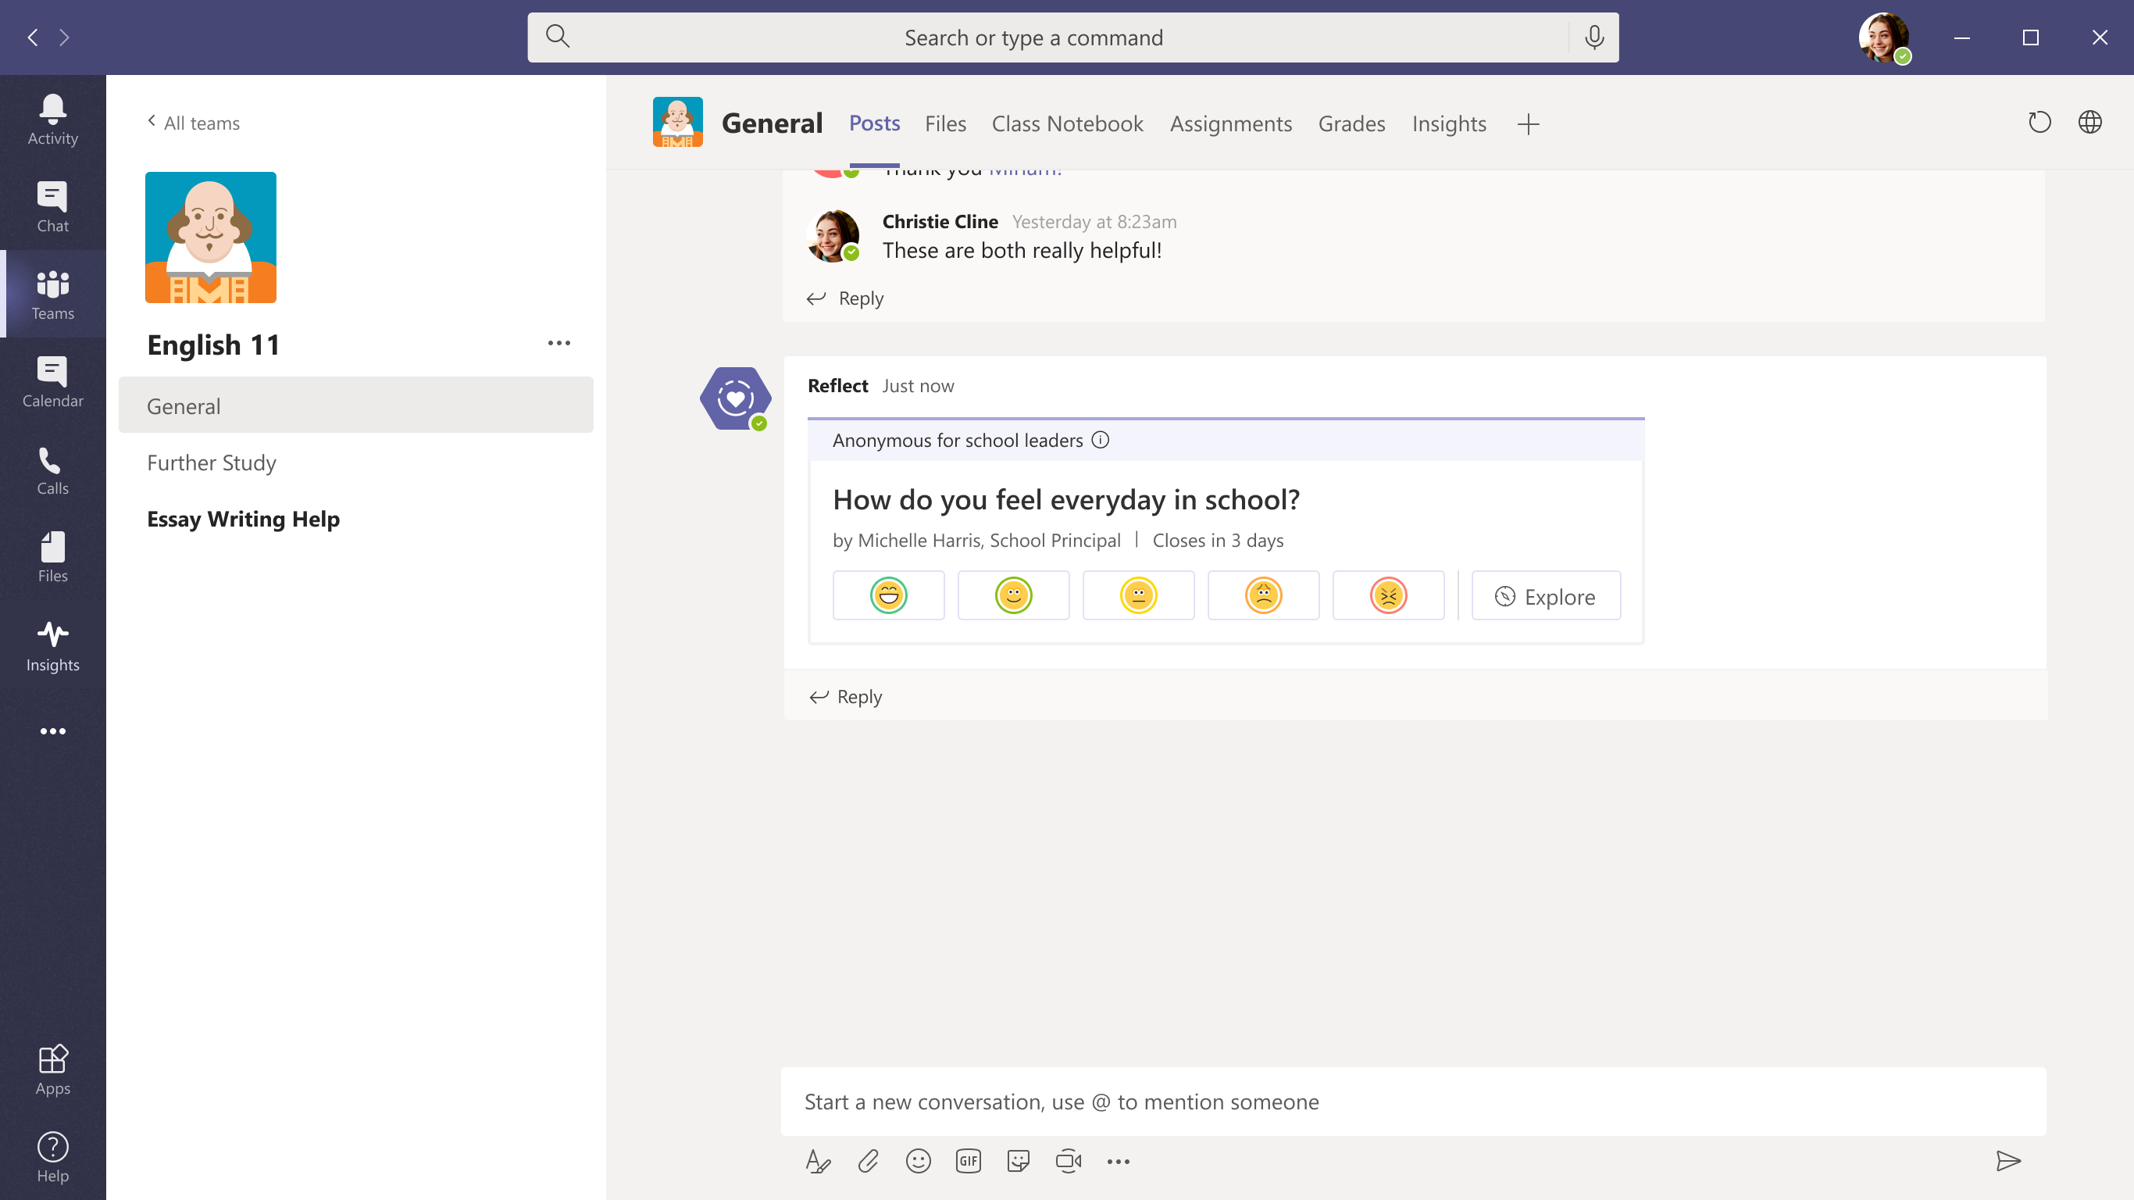
Drive a positive school climate with Reflect 2
Notes:
[Summer 2021]
Third Pillar: school climate
Reflect also helps you understand the school’s emotional climate.
Use it as a tool to ask students every day how they feel at school.
The emotions felt by students, whether pleasant or unpleasant, contribute to this climate.
And we can learn so much from the school climate -
that may raise issues with the norms, values, teaching and learning practices, and relationships within the school.
To make sure we get authentic responses from our learning community, we only show aggregated results and not individual names.
You can zoom in to check the climate or mood of a specific department, grade, class or program;
and if needed provide support for the relevant educators and students.
There is no “score”. The goal is to understand the current situation, how that impacts students,
and to work together to create a more positive school climate and foster greater wellbeing in schools.
We want to make schools a place where student emotions are valued, and everyone feels safe and heard.

Slide 28

AI for Accessibility
A five-year, $25 million program that harnesses power of AI to amplify human capability
Focus areas:
    Education
    Ensure accessibility of learning materials, language development, and assistive technology options
    Employment
    Attract, retain, and upskill talent with disabilities, including workplace accommodations
    Community
    Improve personal connections to maintain relationships and mental health
    Home
    Advance opportunities in appliances, healthcare, transportation, and safety
Learn more: aka.ms/AIforAccessibility
Notes:
We believe that AI can unlock solutions to some of the biggest challenges people with disabilities face. ​
​
That’s why in 2018 we launched AI for Accessibility, a $25 million, 5-year program aimed at leveraging the power of AI to create new assistive technology that will amplify the capabilities of people with disabilities.​
​
There are many ways to cultivate intelligent experiences for people with disabilities. AI for Accessibility focuses on three areas: Employment, daily life, and communication.​

Slide 29

The benefits of a low-code development platform
Increase productivity and agility across your organization
Efficient
Teams can simultaneously develop apps for multiple
platforms and rapidly provide working examples.
Flexible
Create flexible apps that accomplish specific tasks. That
flexibility is critical for scaling and extending apps to
quickly finish projects.
Responsive
Easily pivot to accommodate roller-coaster market shifts
with new digital initiatives.
Repeatable
Provide customers with a consistent, frictionless experience
using prebuilt templates and chatbots.

Slide 30

Power Apps
The world’s most complete low-code platform
Core to the most capable cloud
Reaching 250M+ users natively in Teams and Office 365, built atop the full depth of Microsoft Dataverse and the Azure cloud connected to 550+ services. Leverage the full depth of your data and solve your greatest business challenges.
Incredible breadth for
fusion teams
Scaling gracefully from simple no-code to mission critical sophistication, Power Apps allows citizen developers to work directly with pros for
advanced solutions.
Massive
enterprise scale
Built on a world-class secure identity platform, with deep analytics and market-leading governance controls, Power Apps enables organizations to build solutions while maintaining governance, security and
quality standards.
Accelerate with
advanced innovation
Shift your low-code apps into high gear with advanced AI, Mixed Reality, analytics, bots, interactive maps, external portals, mixed reality, IoT
and more and hyper automation

Slide 31





Education customer momentum: Power Apps
91% of the Fortune 500 use Power Apps to build applications
Education

Slide 32



Use cases
01
02
03
Get a comprehensive view of student progress
Manage institutional processes in a single location
Booking/Attendance App

Slide 33

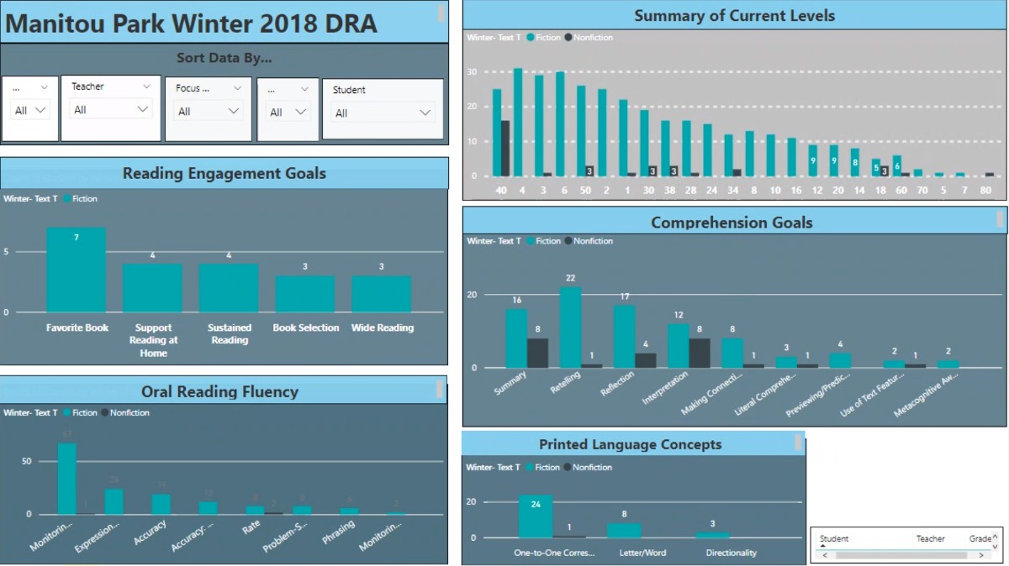
Get a comprehensive view of student progress
How it works
Steps to consider
Create your Power Apps solution
Connect to your data sources such
as Microsoft Dataverse
Develop an intuitive UI for users
to navigate through the solution
Integrate Power BI dashboards
for easy data visualization
Pin solutions in Teams to enable collaboration among educators

Slide 34


School principal builds
Power Apps solutions for teachers and students
“These tools help you to imagine anything and just do it. There aren’t any walls on your imagination anymore. ... My work is hard, but being able to get creative, think outside the box, and provide solutions for others for some reason brings me peace!”
Lauren Taylor
Assistant Principle,
Tacoma Public Schools
Tacoma Public Schools uses Microsoft Power Apps to track student reading levels. This easy-to-use application delivers an intuitive UI for teachers to input student data and notes. This data is then transferred using Power Automate to a Power BI dashboard for immediate visualization. Educators can view this data within Teams for easy collaboration.

Slide 35
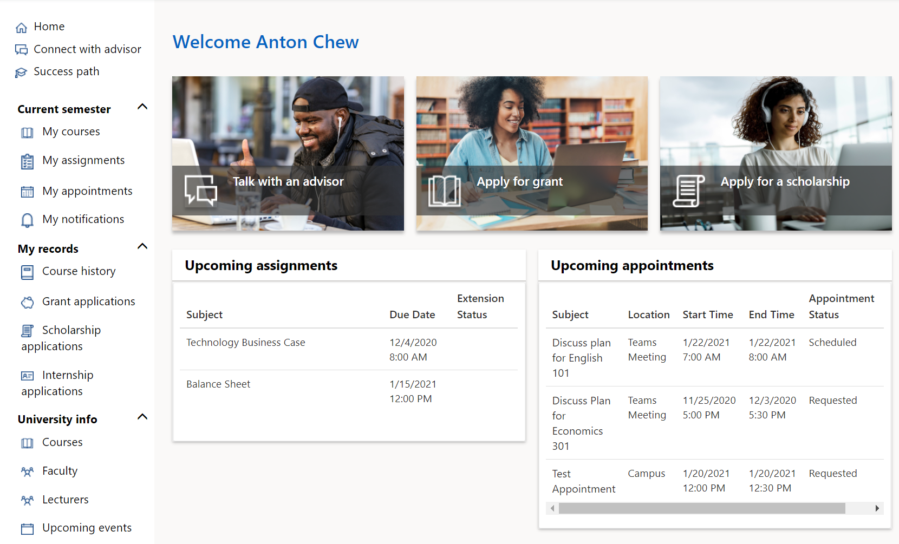
Manage institutional processes in a single location
How it works
Steps to consider
Create your Power Apps solution
Connect to your data sources such
as Microsoft Dataverse
Gather data from SharePoint
Send alerts to approvers to ensure timely response to requests
Surface solutions in Teams for collaboration across the institution

Slide 36

University of Oxford empowers staff with
Power Apps solutions
“It’s a lot of work that’s made easier by using Power Apps to automate many of the manual and repetitive tasks that our staff have to do. This frees up time that our staff can use to focus on more pressing matters.”
Matthew Castle
Head of Application Platforms IT Services,
University of Oxford
The University of Oxford has created a range of easy-to-use apps that help people in various roles across the university. These include apps that handle course fees, funding applications, assigning colleges, ID cards and email accounts to new students, and childcare services and travel insurance for staff.

Slide 37
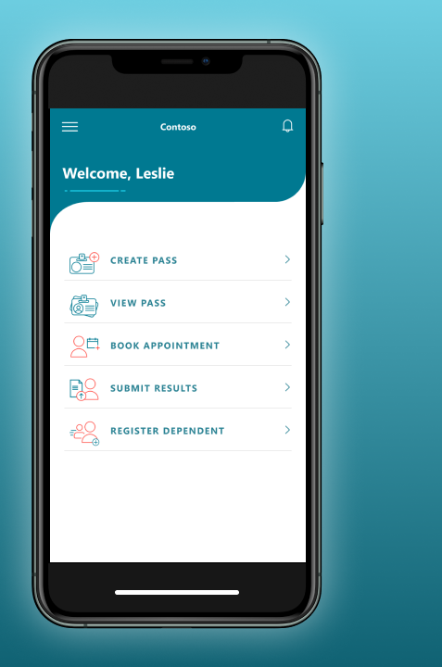
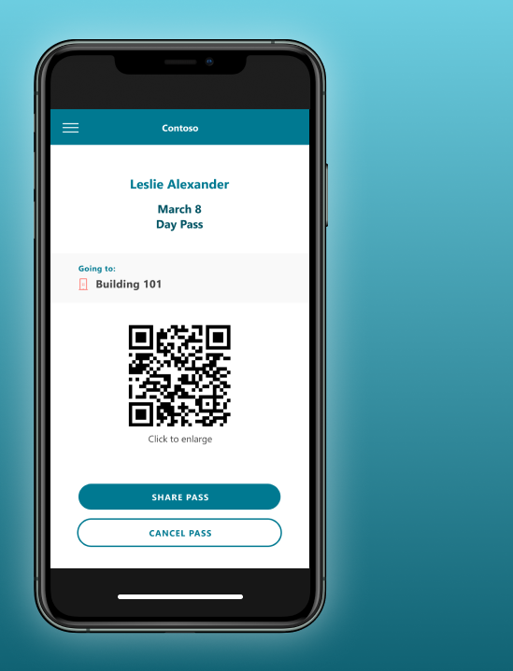
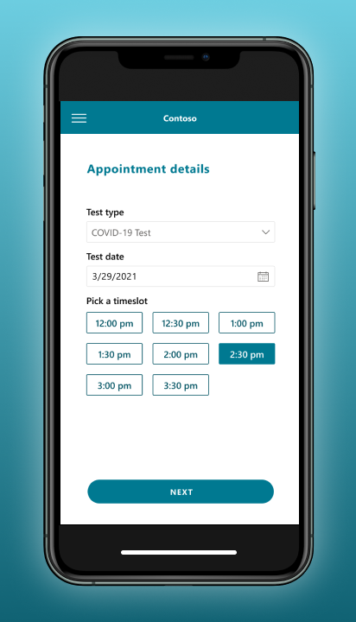
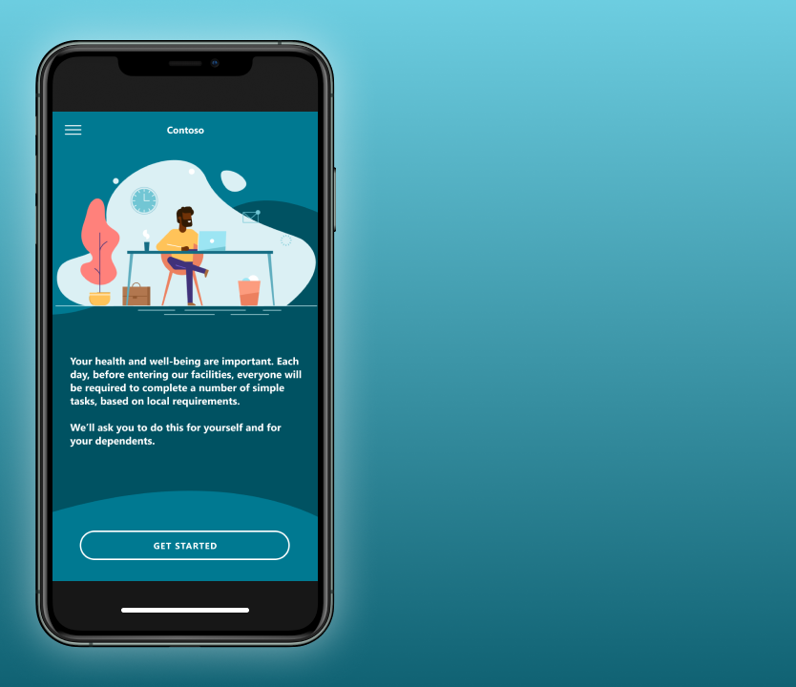
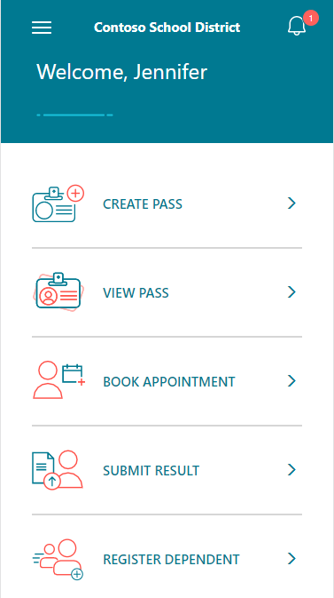
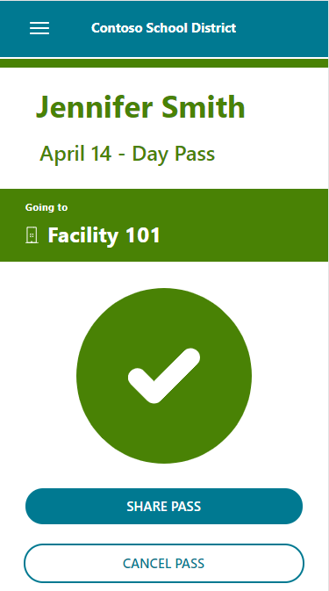
Use case 03

Slide 38
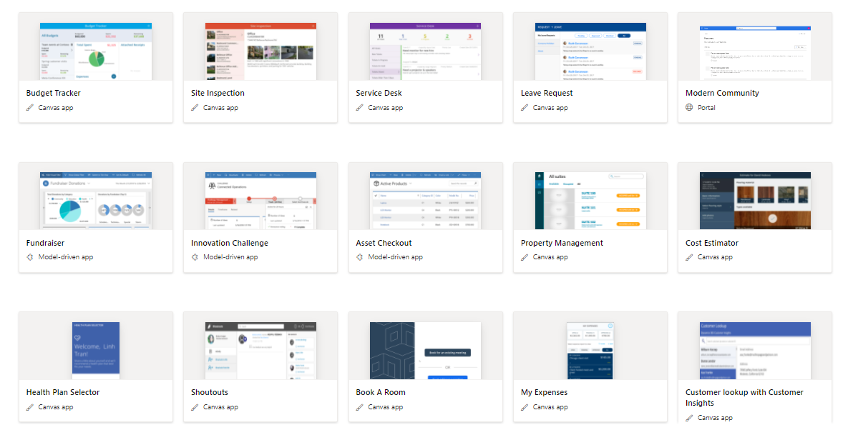
Ready templates for quick time to market
Access:
https://powerapps.microsoft.com/en-us/
https://powerapps.microsoft.com/en-us/blog/category/templates/
Notes:
Apart from apps that you can build for T&L, here are some templates that is ready made for you, for your daily operational activities. With your current subscription of M365 A5, you do have some of these capabilities available, it is a matter of using these ready-made templates.

Slide 39
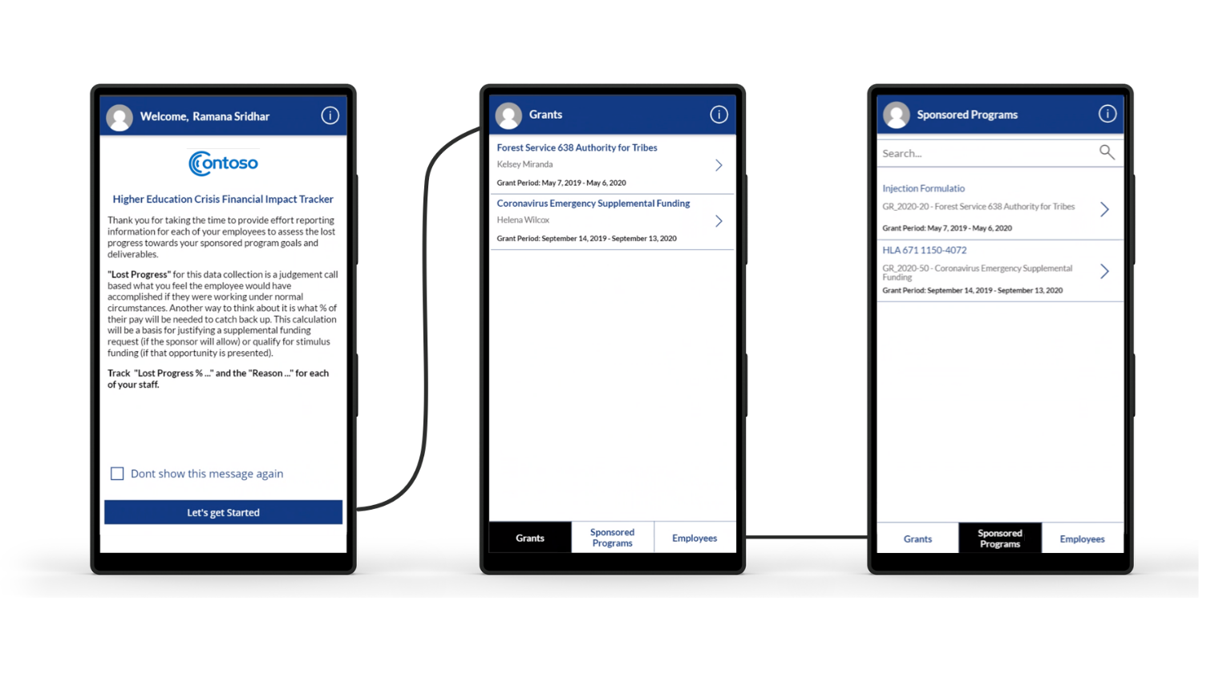
Ready-made templates for education scenarios
Review:
Overview of Higher Education Crisis Financial Impact Tracker - Sample solution - Power Apps | Microsoft Docs

Slide 40


New York board of cooperative education services digitizes paper trail
“Having all the different connectors built into our [Power Apps solutions], to be able to connect the data—being able to make the silos into something that’s more functional—that was a big selling point.”
Corey Fiacco
Solution Technologist,
Monroe One BOCES
Monroe One BOCES is one of 37 Boards of Cooperative Education Services operating
in New York State.
12,000+ sheets of paper and associated print costs saved in 2019.
Notes:
School administration and operations faces many of the same challenges that businesses do. In the case of Monroe One, operating in New York State, they realized their administrative staff was spending hours every week manually entering worker’s compensation claims and following up with the required paperwork.
Used Power App to build an app to digitize the paperwork for worker’s compensation claims
With the data collection capabilities this enabled, they identified “hot spots” where claims were more frequent
Discovered locations with less safe working spaces, were able to fix them
Continued to digitize across the district, from nurse’s offices in schools to HR paperwork

Slide 41
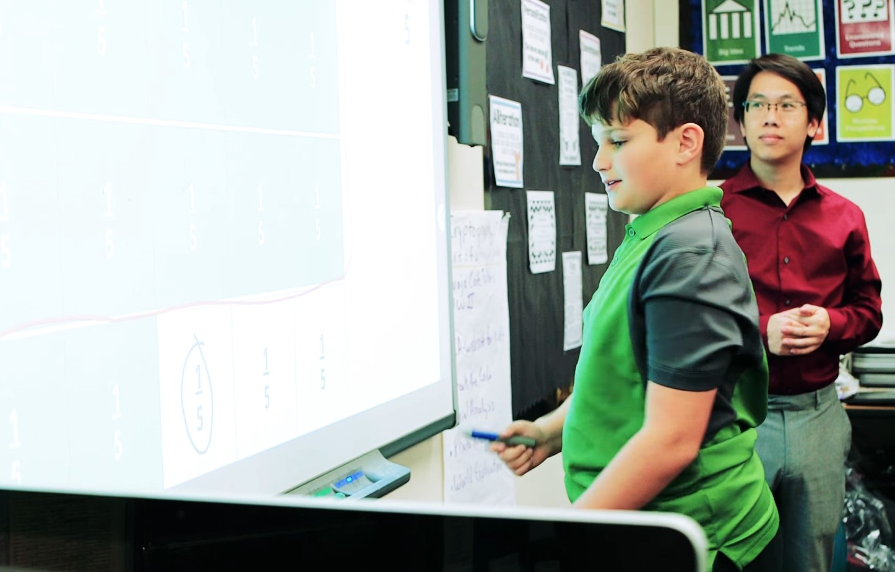
Teacher creates apps that transform classrooms across his school
“Power Apps allows ordinary people like
me to create their own apps straight inside
a website.”
Brian Dang
Teacher,
Trabuco Mesa Elementary School
Using Microsoft Power Apps and Microsoft Power Automate, grade-school teacher Brian Dang is transforming classrooms with apps that help him and other teachers stay organized, teach more effectively, and gamify important parts of the learning experience.
Power Apps makes it easy for IT, professional developers, educators, and students to work together to transform ideas into apps using a secure platform.
Notes:
Mr. Dang impressed us so much with his Power Apps for his classroom that we hired him to teach other teachers how to build the apps they need.
Here’s some examples of what Mr. Dang has built:
Gamifying the classroom
Students earn badges for different levels or participation
Students get super enthusiastic about what the next participation activity is so they can continue to build toward the grand prize.
Spelling app
Students must spell and pronounce the word correctly before moving on
They can do this at their own pace, with the app correcting them appropriately so they learn
Math shapes app
Students identify triangles, isosceles, and unilaterals
Mr. Dang says that Power Apps has let ordinary people like him be able to solve the problems they have in the classroom.

Slide 42
Empowering every institution, educator and learner to achieve more

Slide 43
THANK YOU
vincentquah@microsoft.com

