Slide 1
ELSA SPEAK
TOP A.I. ENGLISH LEARNING APP

Slide 2
VISION & MISSION
Elementary school students
High school students
ELSA was created to become the best and most accessible pronunciation training tool for more than 1.5 billion language learners around the world, enabling everybody to speak English confidently and fluently and unlock new opportunities in their lives.
With ELSA,
everyone can be understood!
College / university students
First jobbers & young professionals
High professionals
Anyone at any age

Slide 3
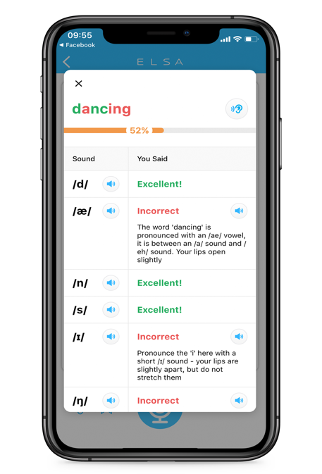
HOW IT WORKS
THE WORLD’S SMARTEST A.I
ENGLISH SPEAKING COACH
Proprietary speech technology using deep learning
Detect pronunciation errors at various levels:
Phoneme level: /æ/
Word level: dancing
Sentence level: I love dancing in the rain
Real-time feedback and phonetic hints
200+ topics | 5,000+ lessons | 26,000+ fun exercises
ADAPTIVE LEARNING TECHNOLOGY
Initial assessment test
Intelligence learning path: customized for each learner
Teaching method optimization
Progress per pronunciation skill

Slide 4
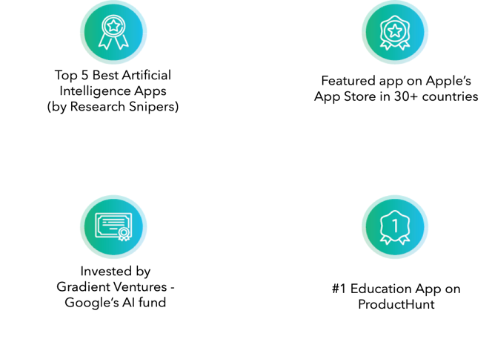
RECOGNITION
Using AI and Big Data to create changes, ELSA has been recognized as one of 26 companies changing the world
CB INSIGHTS AI 100 2021

Slide 5
ELSA SPEAK BY THE NUMBERS
4.7 stars with 300k reviews
Invested by Google Gradient Ventures
40
million+
downloads globally
Users in
100+
countries
Over
5K lessons
available
10
million+
downloads in Vietnam
94M
total lessons completed in Vietnam
207M
total lessons completed globally

Slide 6
Introducing
ELSA FOR SCHOOLS
A unique solution for English speaking training

Slide 7
ELSA ENGLISH TRAINING SOLUTION
made to complement, enhance and empower students and teachers, inside and outside the classroom.
RESOURCES CONSTRAINT
ELSA dedicated resources to support schools
COST
CONSTRAINT
ELSA cost-efficient AI learning solution
CUSTOMIZED PROGRAM
ELSA Tailored-made English training
STUDENTS
ENGAGEMENT &
COMMITMENT
ELSA app learning anywhere anytime.
+
Engagement activities
MEASURABLE IMPROVEMENT
ELSA Dashboard

Slide 8
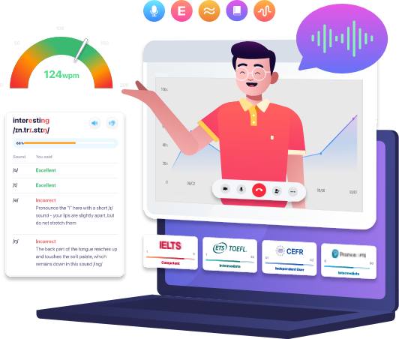
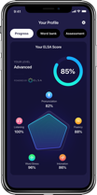
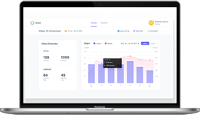
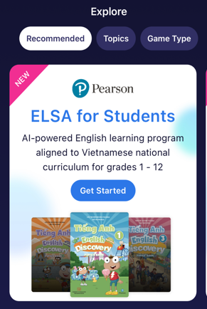
CORE OFFERING
PREMIUM OFFERING
ELSA APP
Mobile learning. Anytime. Anywhere
DASHBOARD
Live progress updates of each learner and the whole organization
EXCLUSIVE CONTENT OFFERING
Speech Analyzer is an AI-powered English speech web app that listens to unscripted/ scripted speech and provides instant feedback.

Slide 9
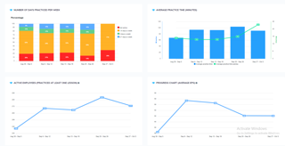
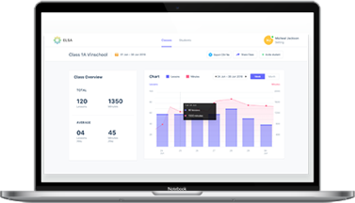
CORE OFFERINGS
ELSA DASHBOARD
Designed for school leaders
A platform that allows organizations to set up teams, invite school leaders, teachers to supervise, create study sets and assign homework to the students.
You can easily manage learning activities, engagement rates, and progress by organization, team, or individual level with the following reporting capabilities:
Lessons Overview
Number of Lessons and Minutes Practiced
Goals Report (Number of Days Practiced Per Week)
Average Practice Time per Day
Active Students Chart
Progress Chart per ELSA Score

Slide 10
THE BEST ENGLISH SPEAKING TRAINING FOR SCHOOLS AND LEARNING CENTERS
SCHOOLS
ENGLISH LANGUAGE TEACHING
Go in-line with English textbook at schools and specifically enhance English speaking for a holistic 4 English skills development
Online & Offline hybrid studying, ELSA is a perfect combination with offline learning at English centers, beside direct interact with teachers in person, ELSA is a 247 supporting AI coach to enhance their speaking skill anywhere anytime

Slide 11
Speech Analyzer is an AI-powered English speech web app that listens to speech and provides instant feedback.

Slide 12
ELSA Speech Analyzer AI-powered English speaking proficiency assessment at scale.
Seamless Live Presentation and Assessment
Ideal tool for English speaking proficiency practice and tests.
Register Unique Voice
Register user voice profile to ensure only their speech is assessed.
Get Instant Feedback and Tutorial for Improvement On 5 areas: Pronunciation, Intonation, Fluency, Grammar, and Vocabulary.
Get Score Predictor
Accurate score predictor of global standard IELTS, TOEFL, CEFR, PTE.
Generate Transcription
Record and get automatic transcription of speech for later review.
Track Progress
Assess users’ English speaking proficiency and follow their progress

Slide 13
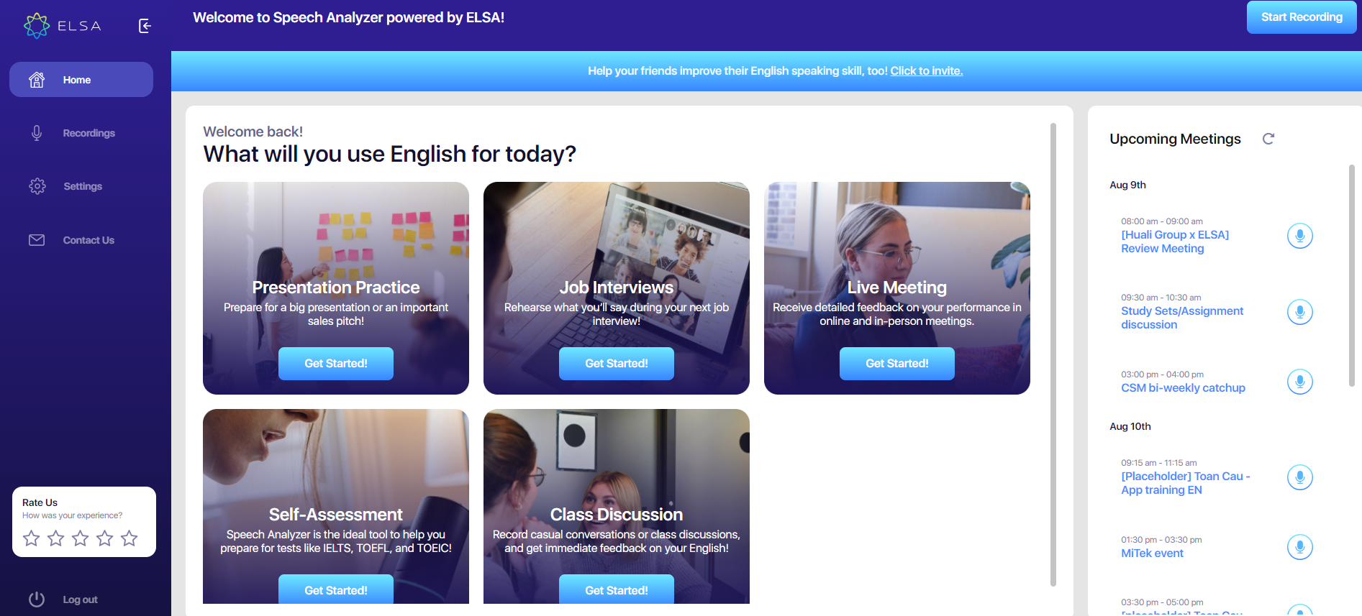
ELSA Speech Analyzer & Use Case

Slide 14
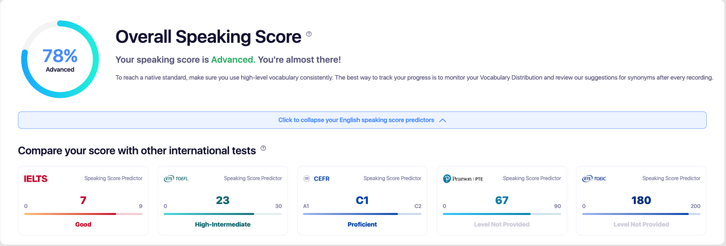
Get Speaking Score
IELTS, TOEFL, CEFR, PTE, TOEIC score predictor

Slide 15
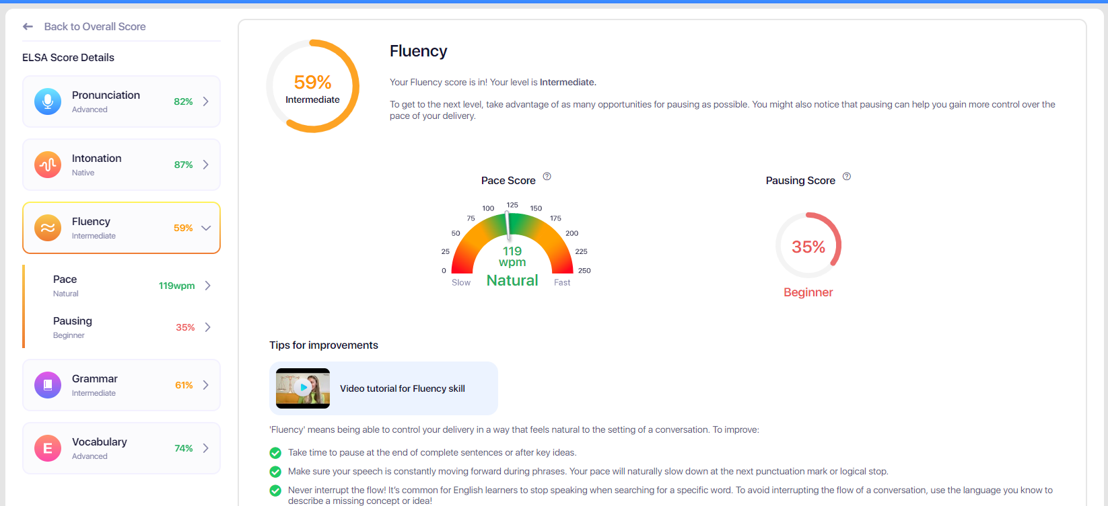
Feedback & Tips for Improvements

Slide 16
ENGAGE YOUR USERS AND
STAND OUT FROM COMPETITORS WITH ELSA API
A game-changing solution for your education platform

Slide 17
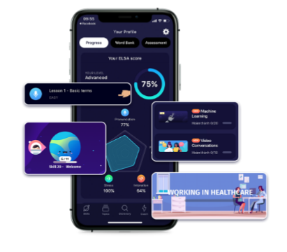
Stand out from competitors by offering world-class
speech features
Speaking is the hardest skill to master when learning a language.
Students need one-on-one practice and instant feedback to help them improve.
Few solutions on the market can offer strong speaking-enabled features due to inhibitive costs of hiring native teachers and a lack of strong speech technology.

Slide 18
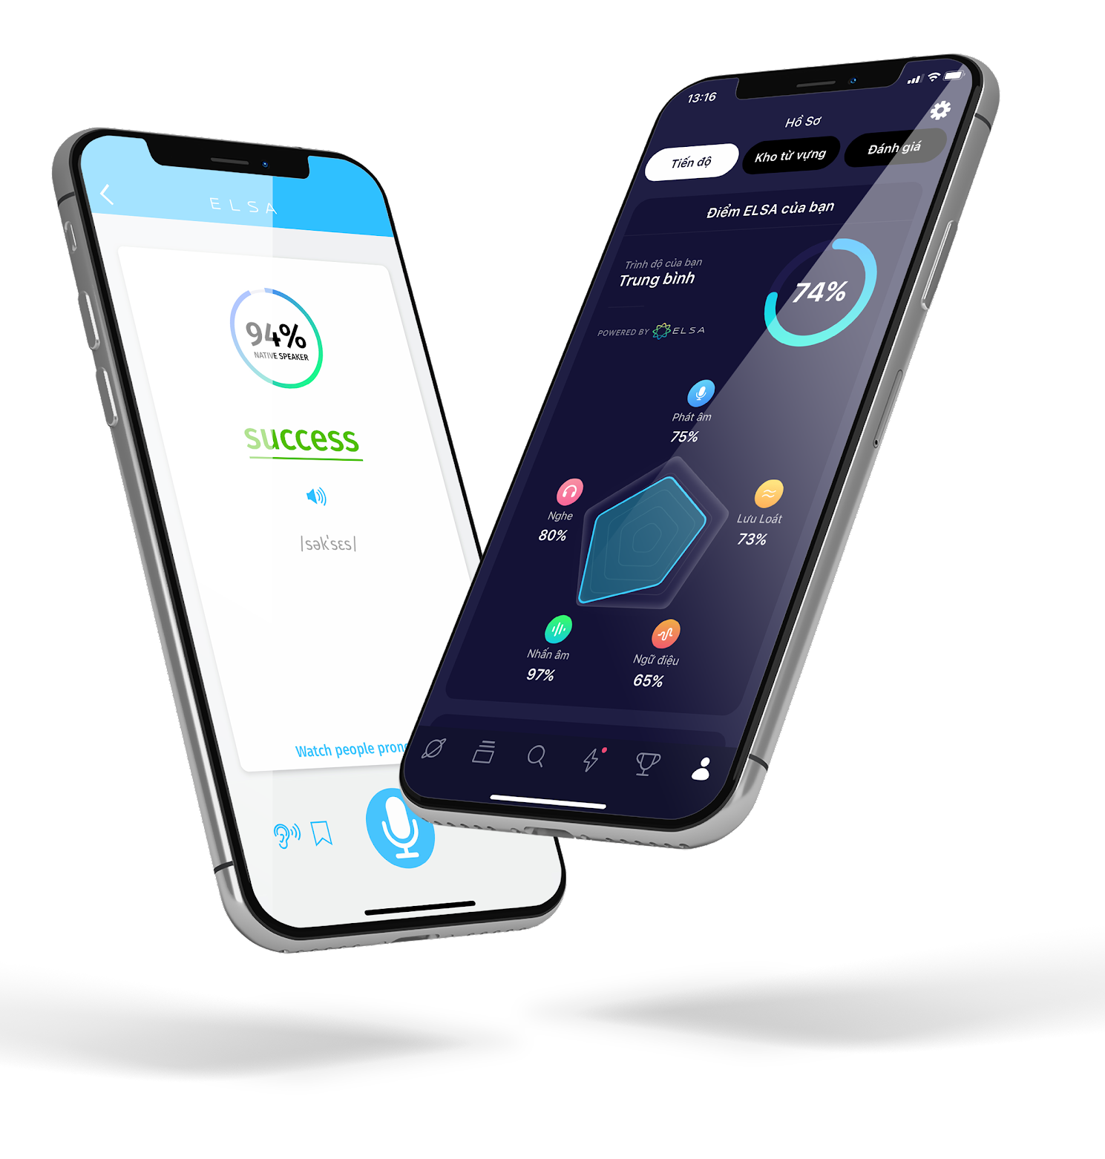
ELSA SPEAK APP IS IN
Top 10%
of language learning apps
with 23 mins
average session time
Adding ELSA Speech API - a high value and interactive feature can greatly boost your app's user engagement - a key success factor in the competitive space of language learning apps.

Slide 19
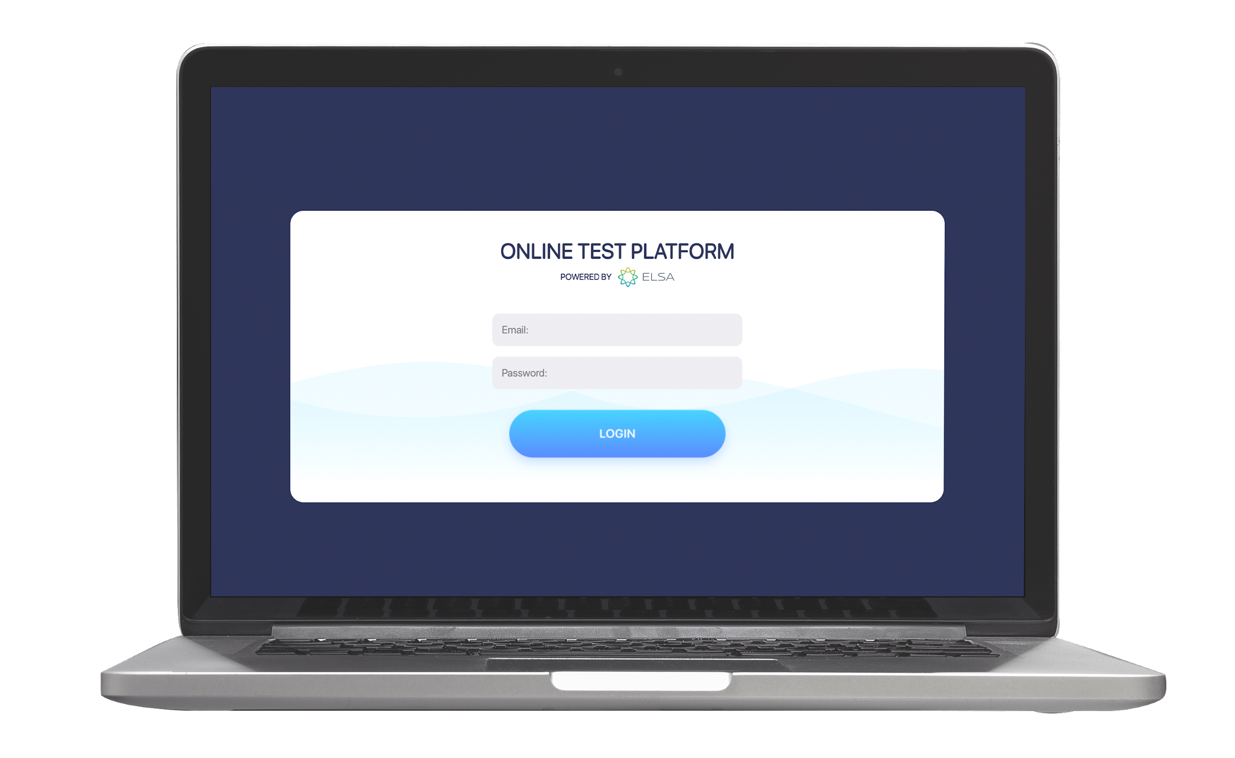
Technology that accurately recognizes
non native accents with +95% accuracy
ELSA has been used by
40+ million users
from 100+ countries in the world
95%
90%
Became more confident
speaking English
Improved their pronounciation

Slide 20
SCRIPTED API
UNSCRIPTED API
Customer provides spoken audio + expected spoken text
ELSA performs analysis on correct pronunciation of the text
Customer provides spoken audio
ELSA performs speech recognition on the audio + analysis on pronunciation + lexical, syntactic and semantic analyses

Slide 21
CLIENTS AND PARTNERS

Slide 22
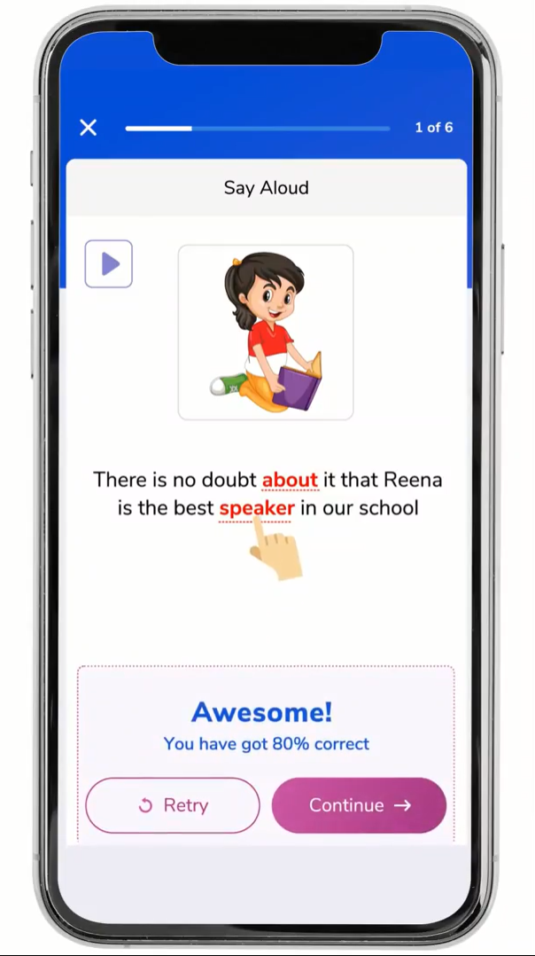
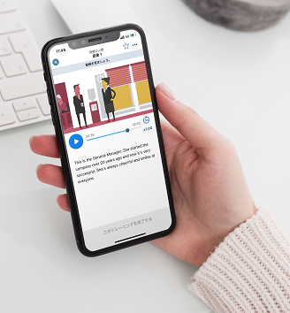
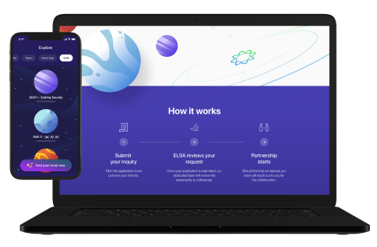
Interactive educational and entertainment channel for kids
Indian-based Edtech Startup
Pioneer e-learning company in Japan to provide English language learning, business and professional skills training platform
Leading Online Education provider in Southeast Asia

Slide 23
ELSA TRUSTED EDUCATION PARTNERS

Slide 24
Thank you

