Slide 1
TIESEA Project Summary
Expert Forum – opportunities and risks for EdTech in Southeast Asia
(TIESEA project) 11th October 2022, BETT Asia, Bangkok

Slide 2
What works with EdTech ?
What particular learning and teaching issues can be addressed using EdTech to improve opportunities and learning outcomes ?

Slide 3
July 2021 – Sep 2023
Focus on four Countries
Cambodia
Indonesia
Philippines
Viet Nam
Four components
Country EdTech inventories & high-level eReadiness survey followed by ideation workshops
EdTech interventions implemented in each country
Evaluation of interventions
Support for scale-up and local capacity building

Slide 4
Q3 & Q4, 2021 – Country EdTech inventory and eReadiness surveys
Baseline country survey, using OASIS tool
Inventory of EdTech projects in-country to date
Evaluation of impact of EdTech interventions to date
Q1 & Q2, 2022 – National and regional seminars
Knowledge-sharing - reporting on national findings
Ideation workshops to identify suitable country interventions
Agreement about the four country interventions
Q4, 2022- Q4, 2023 – Implementation
Interventions operating in each of the four countries
Hardware & software components providing support for the intervention
Rigorous monitoring and evaluation protocols
Impact assessment and reporting
Q4, 2023 - Support for scale-up and local capacity building
National and Regional capstone conferences to share findings
What works in EdTech
National EdTech implementation roadmaps for each country
Teacher confidence

Slide 5
National and Regional workshops
In-person events impossible during early 2022 due to prevailing travel restrictions
The following workshops and knowledge-sharing events took place as webinars:
Early January, 2022 – individual country workshops for knowledge sharing and ideation in Cambodia, Indonesia, Philippines and Viet Nam
February, 2022 – Regional workshop with high-level representation from JFPR, ADB and Education Ministries
Current opportunities for face to face and hybrid workshops
October, 2022 – Regional workshop as part of BETTAsia ‘22
September, 2023 country workshops / F2F and online /
Final Major Project closeout conference – F2F and online

Slide 6
Outline of proposed interventions in the four partner countries
Cambodia – STEM learning with digital resources and offline access
Indonesia – Support and development of existing digital initiatives for teachers’ continuous professional development
Philippines – work with the training agency responsible for Technical and Vocation Education (TESDA) for hybrid and offline instances of digitally-enhanced skills training
Viet Nam – Development of communicative approach and enhancements to speaking and listing skills through student access to language learning app on mobile devices

Slide 7
Assessment of EdTech Readiness & TIESEA Intervention CAMBODIA
Expert Forum – opportunities and risks for EdTech in Southeast Asia
(TIESEA project) 11th October 2022, BETT Asia, Bangkok

Slide 8
Presentation Outline
Introduction
5 pillars of E-Readiness
Infrastructure
Government
Schools/Teachers
Home students/parents
EdTech providers
Review of potential pilot intervention for Edtech in Cambodia

Slide 9
Introduction: Cambodia stats at a glance (Jan 2021)
Cambodian population: 16.83 million (51.2% female)
Internet users in Cambodia : 8.86 million (52.6% internet penetration)
Social media users: 12.00 million (71.3% of the total population)
Mobile connections: 21.18 million mobile connections 125.8% of the total population
Network Readiness Index (NRI) ranking: 106th out of the 130 economies included in the NRI 2021

Slide 10
Infrastructure: Telephony and Internet
Telephony 21.18 million mobile connections in Cambodia in January 2021 (Kemp, 2021)
Internet ranks 66th in terms of mobile data rates in the world, 8.86 million internet users (52.6% internet penetration) (Kemp, 2021)
Lack of computers in households, 41.1% of households in the Asia & Pacific region have access to computer, 13.3% of Cambodian households have access to a computer (ITU, 2019)
TV, 18 TV stations, TV is the most popular media type in Cambodia, reaching 96% of the Cambodian audience.
Radio, 175 radio stations: 4 most popular radio stations gather 43% of listenership

Slide 11
Government: Policy and Funding
Policies
Rectangular Strategy Phase IV,
ICT Master Plan 2020,
Telecom/ICT (T-ICT) Development Policy 2020,
Law on Telecommunication, and the
ICT Strategic Framework.
Funding
As yet, no dedicated budget line for EdTech expenditure designated for usage in schools and the sub-national level

Slide 12
School/teachers: Teacher capacity in Edtech
Pre-service training on ICT, but small amount of in-service training
Pre-service training typically focuses on MS Office suite, internet browser, or using Windows operating system on a PC
Major barriers to EdTech use in schools include:
Lack of computers.
No or poor Internet access, particularly unreliable and/or insufficient bandwidth.
Absence of or unreliable LAN infrastructure in schools.
Lack of competent staff to manage the EdTech infrastructure and support users in schools.
Only 5% of lower secondary schools and 17% of upper secondary schools have access to computer labs.
Only 13.3% of Cambodian households have access to a computer.
40% of upper secondary schools have access to the internet and in most cases use for administrative purpose only.

Slide 13
Home students/parents: Digital literacy of students
In the Global Competitiveness Report 2019, Cambodia ranked 112th out of 141 countries for digital skills among the active population.
Most of the students interviewed have no knowledge about online safety at all, while most of teachers interviewed admitted that they did not teach their students regarding safety measures online
Parents lack knowledge regarding digital devices and their functionalities and provided little to no support at all to their children when using learning devices at home.
Literacy unevenly spread across regions. Students in more advanced areas tend to have better ICT skills and more access to support programs.
During the spread of COVID-19, many students still do not have adequate digital skills to receive classes online.

Slide 14
Providers – public/private partnerships: E learning systems
Many public and private providers providing different products and services for E-learning platform in Cambodia.
Major players like UNESCO, UNICEF, ADB, JICA and many other private sector offers, including different products and services, such as a school management system, attendance, online library management, document storage, various educational apps and Education TV etc.

Slide 15
Key Finding for Edtech in Cambodia
Community/student/parents
School/teachers
National/ministry
Low digital literacy skills among parents and students.
Limited access to ICT resources.
Limited access to ICT resources among teachers.
Lack of competent staff to manage the EdTech infrastructure and support users in schools.
Limit ICT training to teachers both Pre-service and In-service.
ICT Master Plan, Policy development, Law on Telecommunication, and the ICT Strategic Framework.
Cambodia has invested significant time and resources into creating and implementing plans to increase the effective use of ICT in education.
Computer Programming integrated into the new national curriculum for students from Grade 4 to Grade 12.
Notes:
Data (of all kinds) drives the influencing

Slide 16
TIESEA Cambodia Proposed Pilot Intervention
Major barriers to EdTech use in schools:
Lack of access to ICT resources
No or poor Internet access
Lack of competent staff to manage the EdTech infrastructure and support users in schools
Working in partnership with public/private sector to address the Edtech barriers
Provide access of internet, devices and necessary training to teachers, students and parents:
Digital literacy training to teachers, students and parents
STEM education, Science Experiment, Project based learning, 21st Century Education and Skills, Teaching Approach/Methods/Techniques etc. training to subject teachers
Implementation of new teaching and learning approach in treatment and control schools
Technical support to teachers and students in the user of EdTech devices in their teaching and learning
Assessing outcome compared with baseline
Reporting and recommendations

Slide 17
Thank you!
For more information on the TIESEA project, visit our website:
www.tiesea.org

Slide 18
Assessment of EdTech Readiness & TIESEA Intervention
INDONESIA
Expert Forum – opportunities and risks for EdTech in Southeast Asia
(TIESEA project) 11th October 2022, BETT Asia, Bangkok

Slide 19
Agenda
Report on the applying EdTech readiness framework to Indonesia
Infrastructure
Government policies
School/teachers & principals
Home/students & parents
Providers/public-private partnership
Progress report on the TIESEA intervention in Indonesia
Overview of the EdTech intervention
1st TPD workshop
Cahya K. Ratih
cahya@seamolec.org

Slide 20
Presented by the Head of the MoECRT Data & Information Centre during TIESEA National Workshop, February 2022

Slide 21
1. Infrastructure: Electricity, Internet Access, Digital Devices
Electricity consumption in Indonesia reached 1,064 kWh pc in 2018, compared to Malaysia, which had reached 4,460 kWh in 2016¹
Indonesia is the 6th largest country of Internet users globally¹ and third in Asia², with a user penetration of 76.84% out of the population³
IDR 1.3 trillion was allocated to purchase 189,840-unit laptops, 12,674 access points, connectors, and projectors, as well as 45 units of speakers. The procurement of 284,147 units of domestic laptops
Electricity
Internet Access
tablets, laptops, LCD projectors, printers, etc.
Digital Devices for Learning
97%
81%
3% or more than 6000 schools without electricity²
19% or ~42,000 schools still have no internet access⁴
______
1 National mid-term development plan 2020-2024
2 The basic education data (Dapodik), April 2021
___________________________
https://www.kompas.com/trend/read/2021/07/30/184500665/mengenal-laptop-chromebook-yang-akan-diborong-kemendikbud-bagaimana?page=all
1 Ministry of Communication and Information Technology (kominfo.go.id)
2 Indonesia's Internet Users Rank 3rd Most in Asia | Databooks (katadata.co.id)
3 HRW WORLD ATLAS – Indonesia
4 https://news.detik.com/berita/d-5108489/kemendikbud-8522-sekolah-belum-berlistrik-42159-tak-ada-akses-internet

Slide 22
Educational Ecosystem (including e-management)
Pleasant school environment, openness to collaborate among educational stakeholders and active collaboration among parents and communities (Sekolah Penggerak, Organisasi Penggerak)
2. Government
Policy on education transformation:
Freedom Learning (Merdeka Belajar)
Evaluation System
more formatives and utilize more portfolios,
no national exams
Teachers
promotes teachers' role
as learning facilitators: Guru Penggerak
increase the quality of learning
increase the quality of educational services
Curriculum
flexibility, competency-based, and focused on the characters and soft skills development,
new Merdeka Curriculum
Pedagogy
Promote the heterogeneous approaches, e-learning, innovative learning

Slide 23
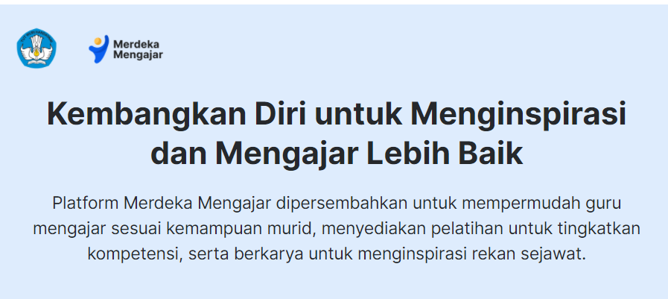
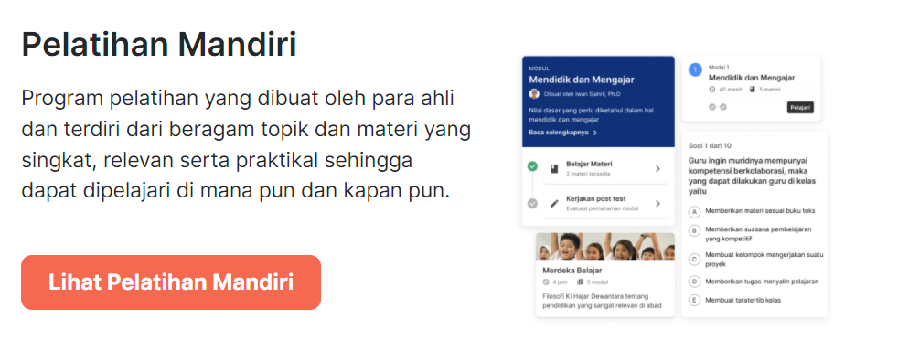
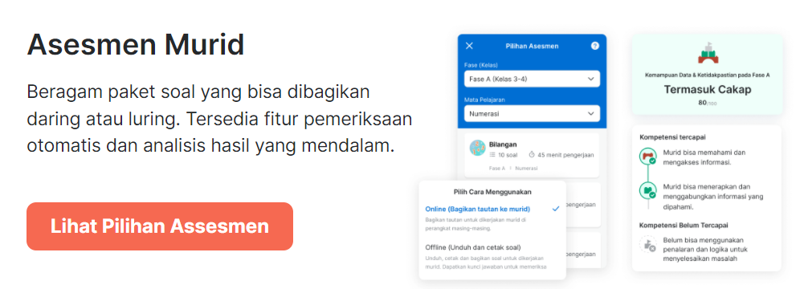
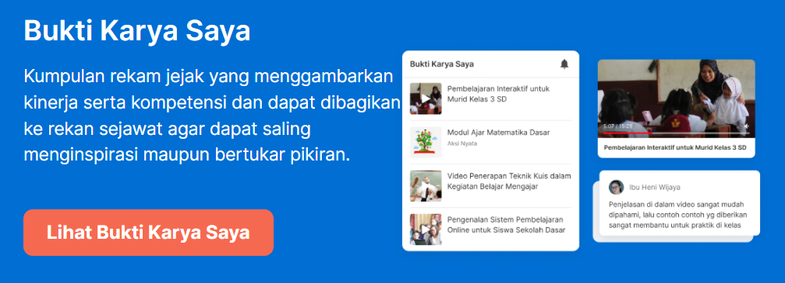
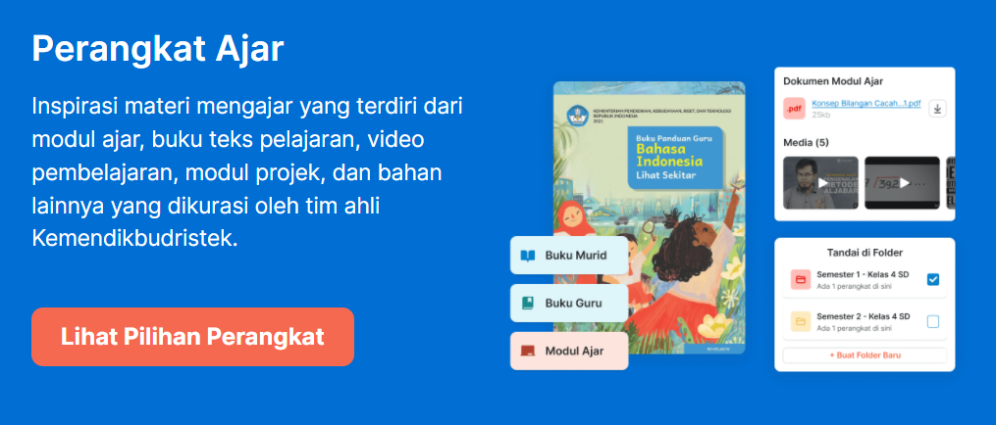
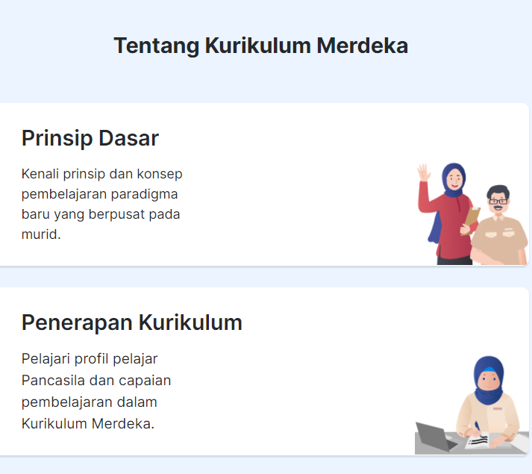
3. Schools/Teachers & Principals
Independent Capacity Building
Students Assessment
e-portfolio
Teaching & Learning Resources
Merdeka Curriculum

Slide 24
4. Home students/parents
In 2020, many students and parents reported not receiving feedback from teachers on assignments or exams¹
Teachers
Parents
Unequal access, low bandwidth and concentrated in more populated developed urban areas
MoECRT and MoRA (2020) partnered with telecommunications operators to distribute free internet quotas for teachers, students, university students, and lecturers to maintain the continuity and quality of education during the pandemic
Public
_______________________
1 World Bank Group, ‘EdTech in Indonesia- Ready for take-off?, 2020
2 Strengthening Digital Learning Across Indonesia: Research Summary, UNICEF, 2020, p.4

Slide 25
5. Providers/Public-Private Partnership
Student-focused Interventions
Teacher-focused Interventions
Admin-focused Interventions
Skills-focused Interventions

Slide 26
TIESEA Intervention
Teachers’ digital Literacy Improvement
21st Century Skills through STEM project-based learning approaches
Schools with Limited access to connectivity and students from low-economy status family
Implementation of Merdeka Curriculum
Active utilization of Merdeka Mengajar Platform
Promoting learner’s lead instructions rather than technology driven

Slide 27
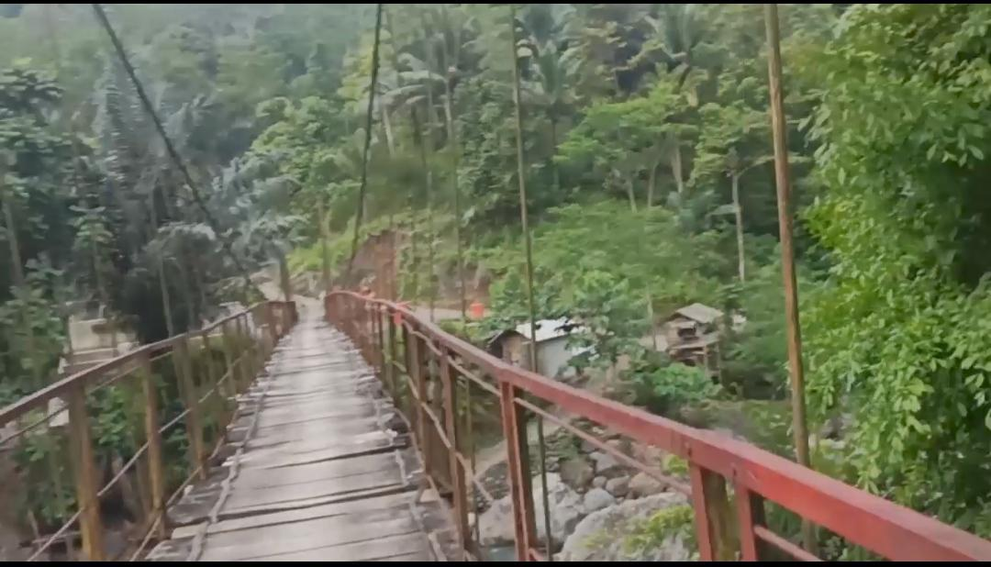
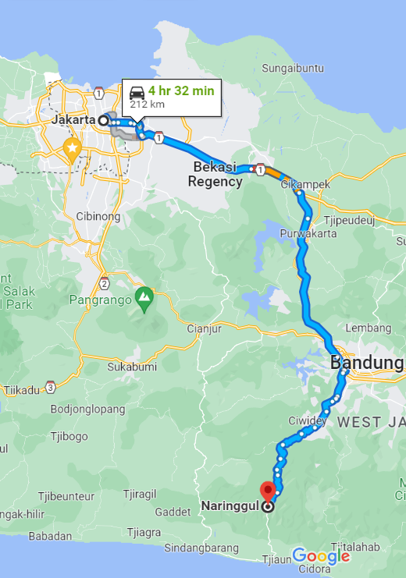
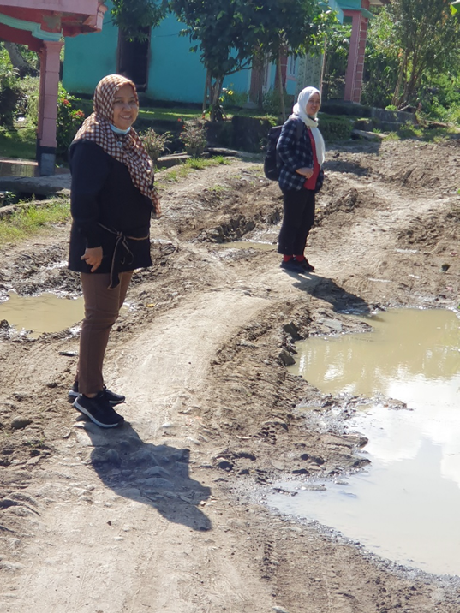
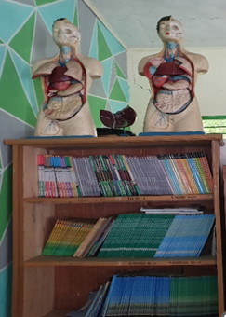
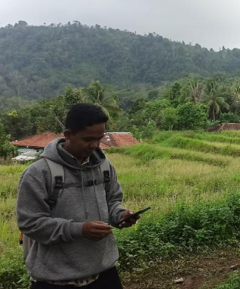
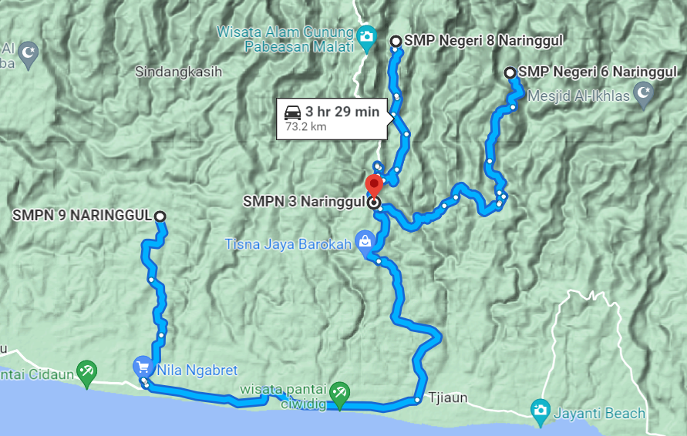
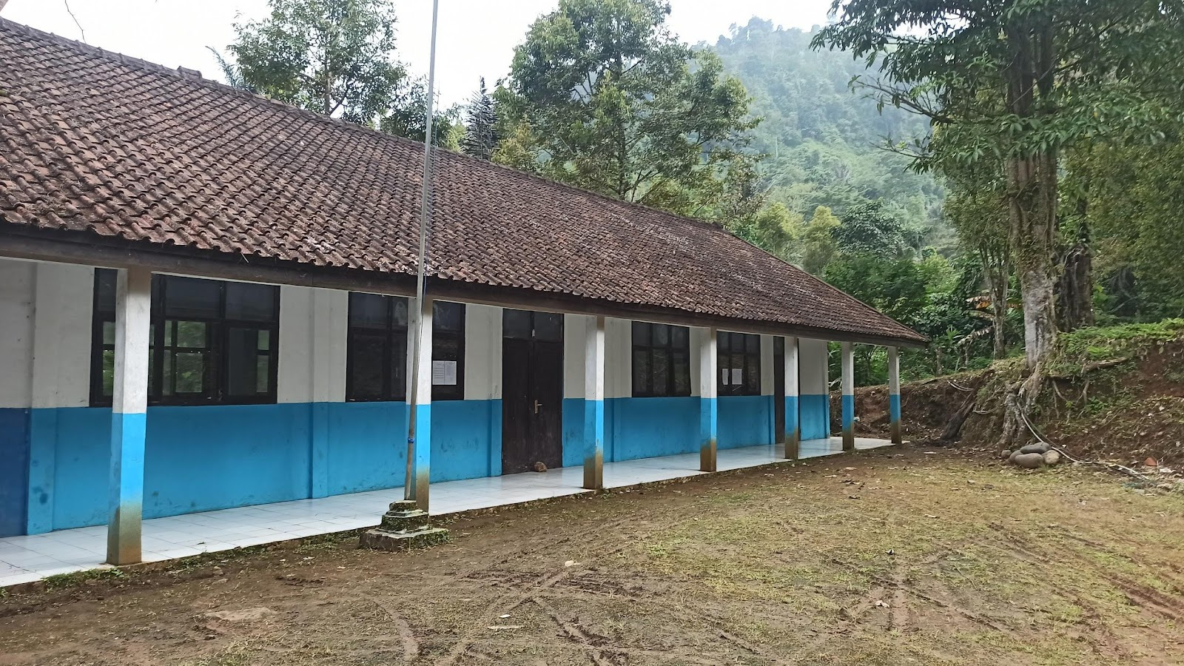
Target Beneficiaries

Slide 28
Strategy
SMPN 3 Naringgul
SMPN 8 Naringgul
SMPN 6 Naringgul
SMPN 9 Naringgul
Area: 7,000 m2
Classroom: 15, Teachers:20, STEM Teachers:3, Students:286,
Electricity: 2200,
Mobile broadband: Indosat, Telkomsel, XL
Area: 2,640 m2, Classrooms:6, Teachers:7, STEM Teachers:2, Students:108, Electricity:450, Mobile broadband: 0
Area: 2,500m2, Classrooms:4, Teachers:8, STEM Teachers:2, Students:83,
Electricity:900, Mobile broadband: 0
Area: 5,830 m2, Classrooms:16, Teachers:9, STEM Teachers:2, Students:156, Electricity:900, Mobile broadband: Indosat, Telkomsel, XL
Hybrid mode TPD: 1)STEM PBL lesson plan development, 2)STEM PBL assessment, 3)Digital media development
Pilot test with EdTech
Pilot test with EdTech
Pilot test without EdTech
Pilot test without EdTech
Pilot test with EdTech
Pilot test with EdTech
Pilot test with EdTech
Pilot test with EdTech
Reporting
https://sekolah.data.kemdikbud.go.id/index.php/Chome/profil/D0512E14-2CF5-E011-82EB-85ED6B81A4A5
https://sekolah.data.kemdikbud.go.id/index.php/Chome/profil/60405A70-5E22-E211-B184-058018946816
https://sekolah.data.kemdikbud.go.id/index.php/Chome/profil/501A61B9-B21D-E211-BEC3-29AE04EBA8B1

Slide 29
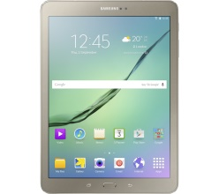
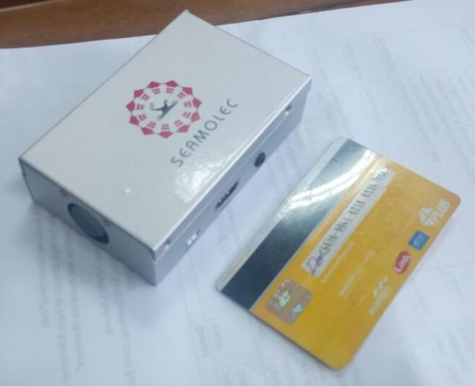
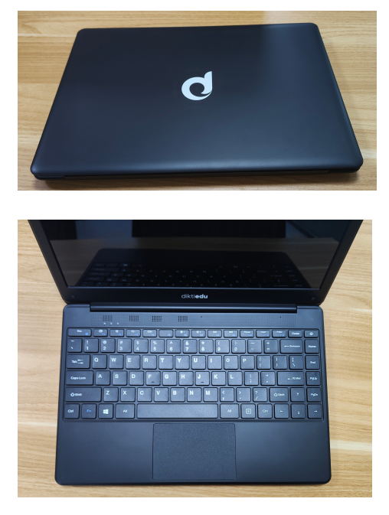
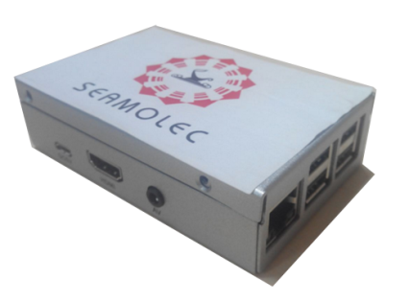
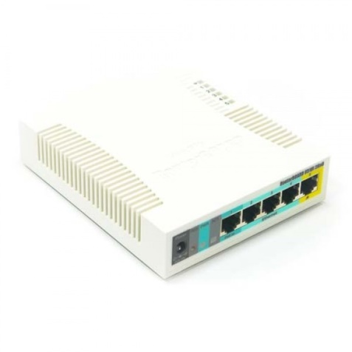
Technology
Students
Students
Mobile Digital Resources
(Mini server)
Digital Library
DiktiEdu Laptops by MoECRT
Students

Slide 30
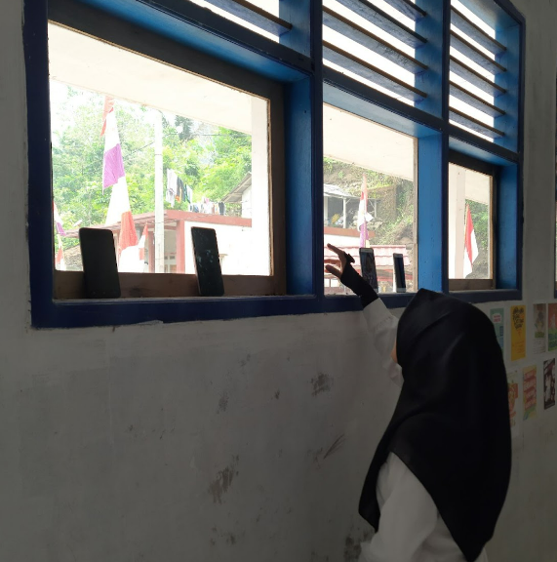
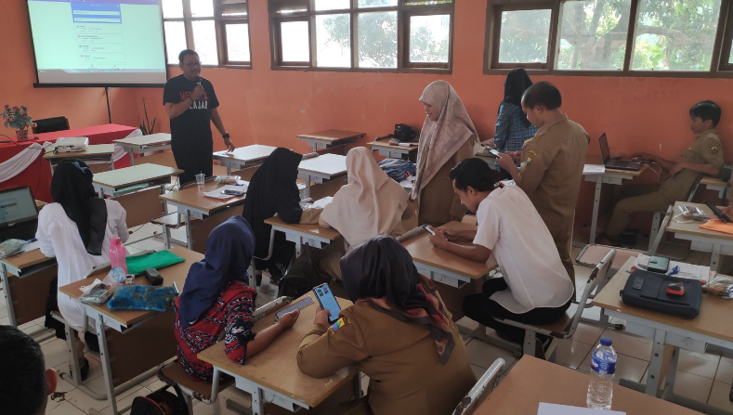
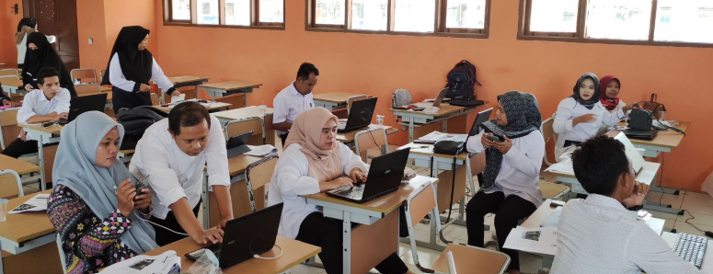
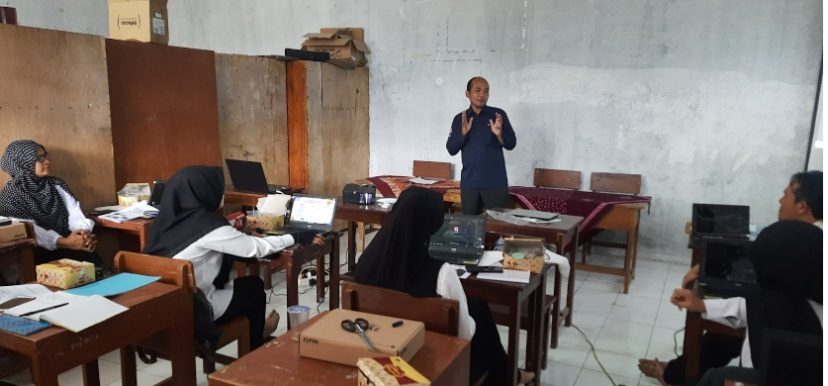
1st TIESEA TPD Workshop
Phase 1: 5-6 September 2022 at SMPN 3 Naringgul
Participants: 14 STEM teachers from 4 schools (Female: 7, Male:7)
Output: STEM PBL Lesson Plan
Topics:
Introduction to Merdeka curriculum & getting familiar with Merdeka Mengajar Platform
Project-based Learning in STEM courses and its lesson plan development
Phase 2: 7-8 September 2022 at SMPN 3,6,8,9 Naringgul
Total participants: 49 teachers (Female:30, Male:19)
Topics: ICT-integrated lesson plan development

Slide 31
Thank you!
For more information on the TIESEA project, visit our website:
www.tiesea.org

Slide 32
Assessment of EdTech Readiness & TIESEA Intervention
PHILIPPINES
Expert Forum – opportunities and risks for EdTech in Southeast Asia
(TIESEA project) 11th October 2022, BETT Asia, Bangkok

Slide 33
Outline of Philippine Report
Part One: Synopsis of E-Readiness Diagnostic
Part Two: Summary of the Pilot Intervention Proposal

Slide 34
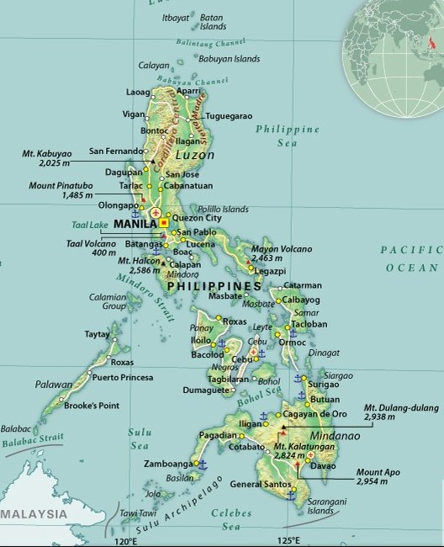
Synopsis of E-Readiness Diagnostic
This report is primarily guided by the five pillars of the ADB EdTech Readiness Framework, which are as follows: infrastructure, government, schools/teachers, parents/students, and EdTech providers.
Demographics that affect EdTech in the country:
the country is an archipelago – 7,641 islands, large population: 100.98 million in 2015

Slide 35
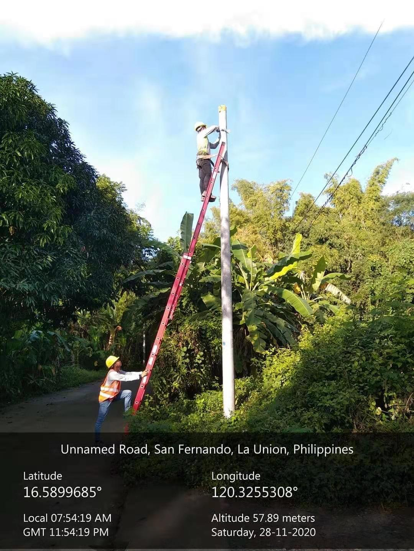
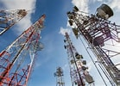
1. Infrastructure: improving modestly
*2020 household electrification level-- 94.5%, but 350,000 learners and 14,000 teachers were not able to avail of the remote learning materials during the pandemic
*Major challenge: Internet speed of only 22.50 Mbps *present reach of 67.0
% of the population the Internet sector contributes significantly to the Philippine economy.
*Positive note 152.4 million mobile connections (138.2% of the total population).
*Mobile phones : most popular among users aged 16 to 64.

Slide 36
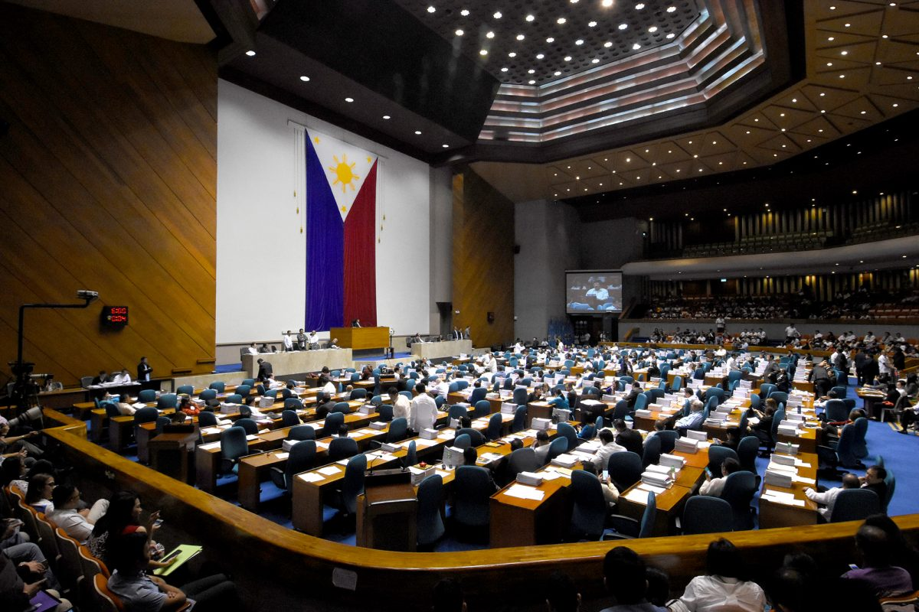
2. Strong communication structures: 952 radio stations; 3 major TV channels with nationwide coverage, 400+ cable stations and community stations
In 2020: 45,869 classrooms with television sets, other gadgets
DepEd and TESDA have partnership arrangements on ed tech
3. Content Creation/Dissemination, primarily
a. DepEd: 2020 Learning Continuity Plan (LCP)
b. TESDA Online Program (TOP):
4.GOVERNMENT: Strong Government strongly supports ed tech, with special attention on hardware provision to schools.
Policy Development/Funding. The Philippine Digital Transformation Strategy (PDTS 2022) developed by the Department of Information and Communications Technology
he

Slide 37
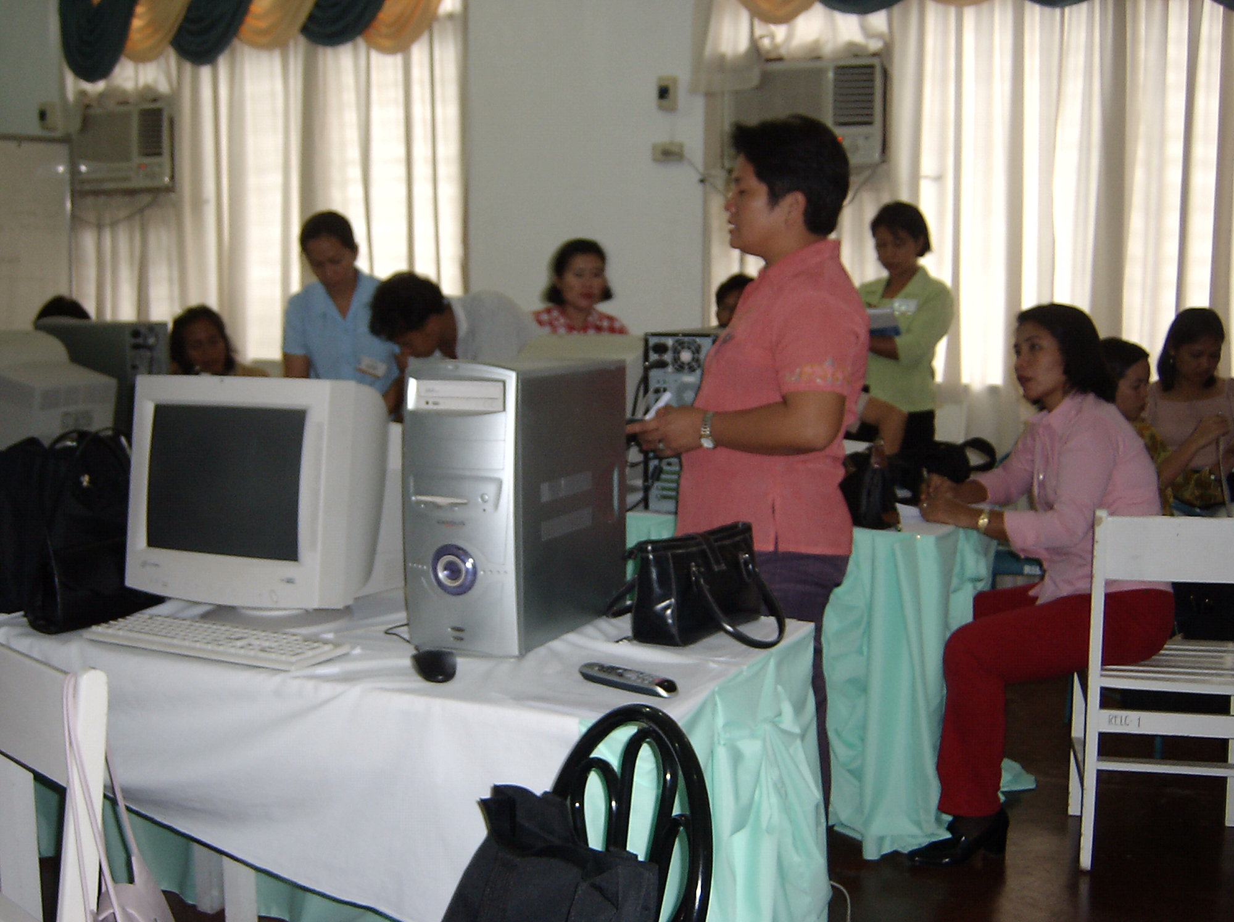
5. School/Teachers: Teacher Capacity in Educational Technology
School administrators/teachers feel the need for adequate training on ICT
Not only teachers need preparation but also government, heads of educational institutions, academic staff, students, parents, academic recognition body
6. Strong Family and Community Support
Filipino families have high acceptance of ICT
Public/private partnerships
Academe
international development agencies Academe
Business sector/private groups (Publishing houses Non-government organizations
Non-government organization and Ed Tech companies

Slide 38
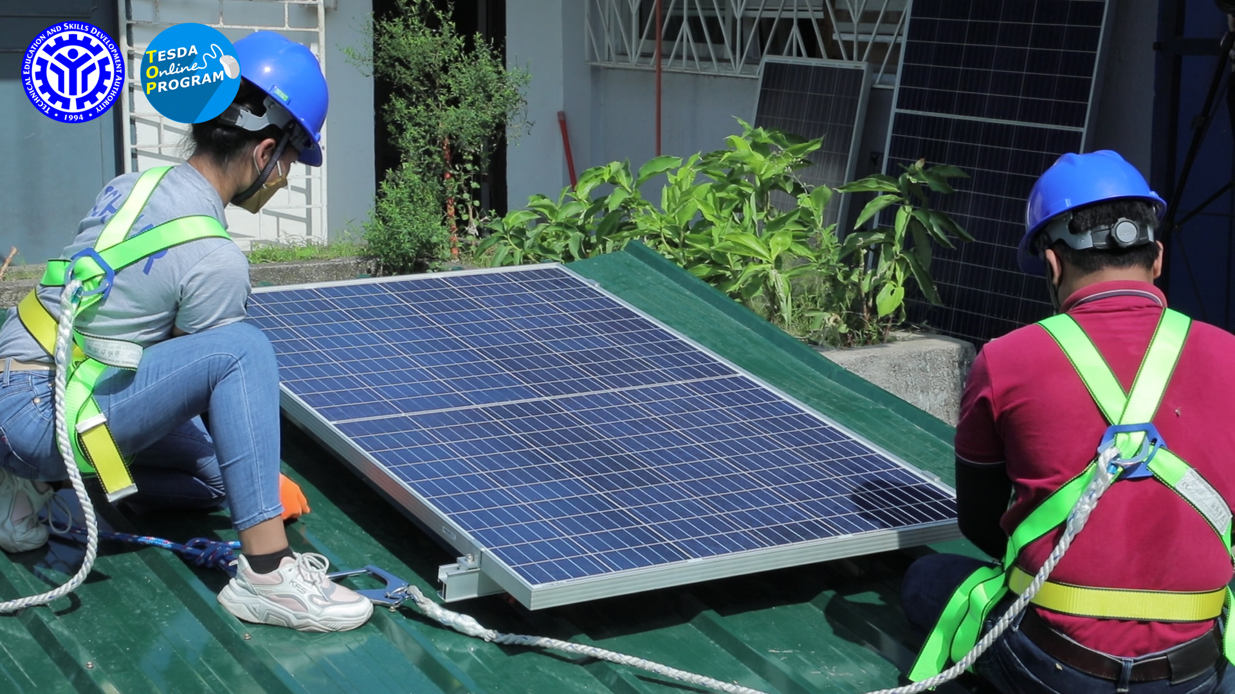
2. Summary of the Pilot Intervention Proposal
Pilot Project Overview, Rationale and Justification
“For every 100 learner who enter Grade I, only 15 finish high school in the country”
Three decades of research finding
High drop-out rate starting from 4th Grade to Secondary School
Reason for dropping out at the secondary level– poverty– need to look for a job or engage in self-employment
Of the 3m out-of-school youth, a substantial number enroll in TESDA Training regulations, such as the TESDA Open Program (TOP) which has become a sought-after program, especially during the pandemic.
This success accelerated the re-design of the TOP to allow for self-paced MOOCs and for facilitated online and blended learning in TESDA Technology Institutions (TTIs). A value-added service in the new iteration of the TOP is the development of a mobile application for offline and mobile learning.

Slide 39
Target Beneficiaries/Partner TTIs
Project sites: four (4) technical training institutions (TTIs): Rosario PTC Cavite; Pili PTC. Camarines Sur, Tagaloan RTC and the Balanginga National Agricultural School, Eastern Samar. They offer the Photovoltaic Systems Installation NC II’ course.
Learner-participants will be Training for Work Scholarship Program (TWSP) beneficiaries. Which “seeks to support rapid, inclusive, and sustained economic growth through course offerings in priority industries and key employment generators
RTC Rosario
RTC Naga
Balanginga National Agricultural School
RTC Tagaloan

Slide 40
Objectives of the Pilot Intervention
Determine the comparative effectiveness of a blended learning delivery through the TOP using its mobile offline and online features served either through the Internet or through a local content server.
Test the effectiveness of a local server using low cost, energy efficient gadgets and equipment to deliver a TOP course and the ability of TESDA training institutions to utilize and maintain such devices
3) Determine the overall training and learning experiences of learners and trainers using EdTech
Pilot Project Hypothesis:
Appropriate EdTech equipment and modern training strategies, including online/offline strategies, are effective in improving access, equity and quality in the delivery of the TVET courses and, specifically, the ‘Photovoltaic Systems Installation NC II
Based on this general hypothesis, the research questions to be addressed: (TESDA Inputs)
Is the TOP PVS Installation program, when delivered in a hybrid mode with an offline content server, as effective as program operating in areas with good internet access and connectivity?
Where the program in running in the outlying provinces, are the program participants able to apply the skills that they have learnt on the PV Installation program and improve community access to electricity?

Slide 41
Project Description
The project implementing partners of the Pilot intervention are TIESEA and TESDA through the eTESDA Division which is in charge of the TOP..
The focus of the pilot project is to successfully deliver the TOP eLearning course, ‘Photovoltaic Systems Installation NC II’, to students in areas with limited or no internet infrastructure by enabling TOP materials to be accessed locally through a content server and Wi-Fi router rather than through the Internet.
Roles and responsibilities
1. Planning – Joint responsibility of TESDA and TIESEA
2. TOT/ training of learners – TESDA (through) eTESDA) and technical training institutions (TTIs)
3. Monitoing and evaluation – joint responsibility of TESDA and TIESEA
4. Fund management
Each of the 4 TTIs shall run 2 batches of 25 learners each during the duration of the Pilot.
The Pilot Project shall focus on the effectiveness and efficiency of MoodleBox on a local server of TVET blended learning materials compared with the standard practice of accessing the materials through the Internet.

Slide 42
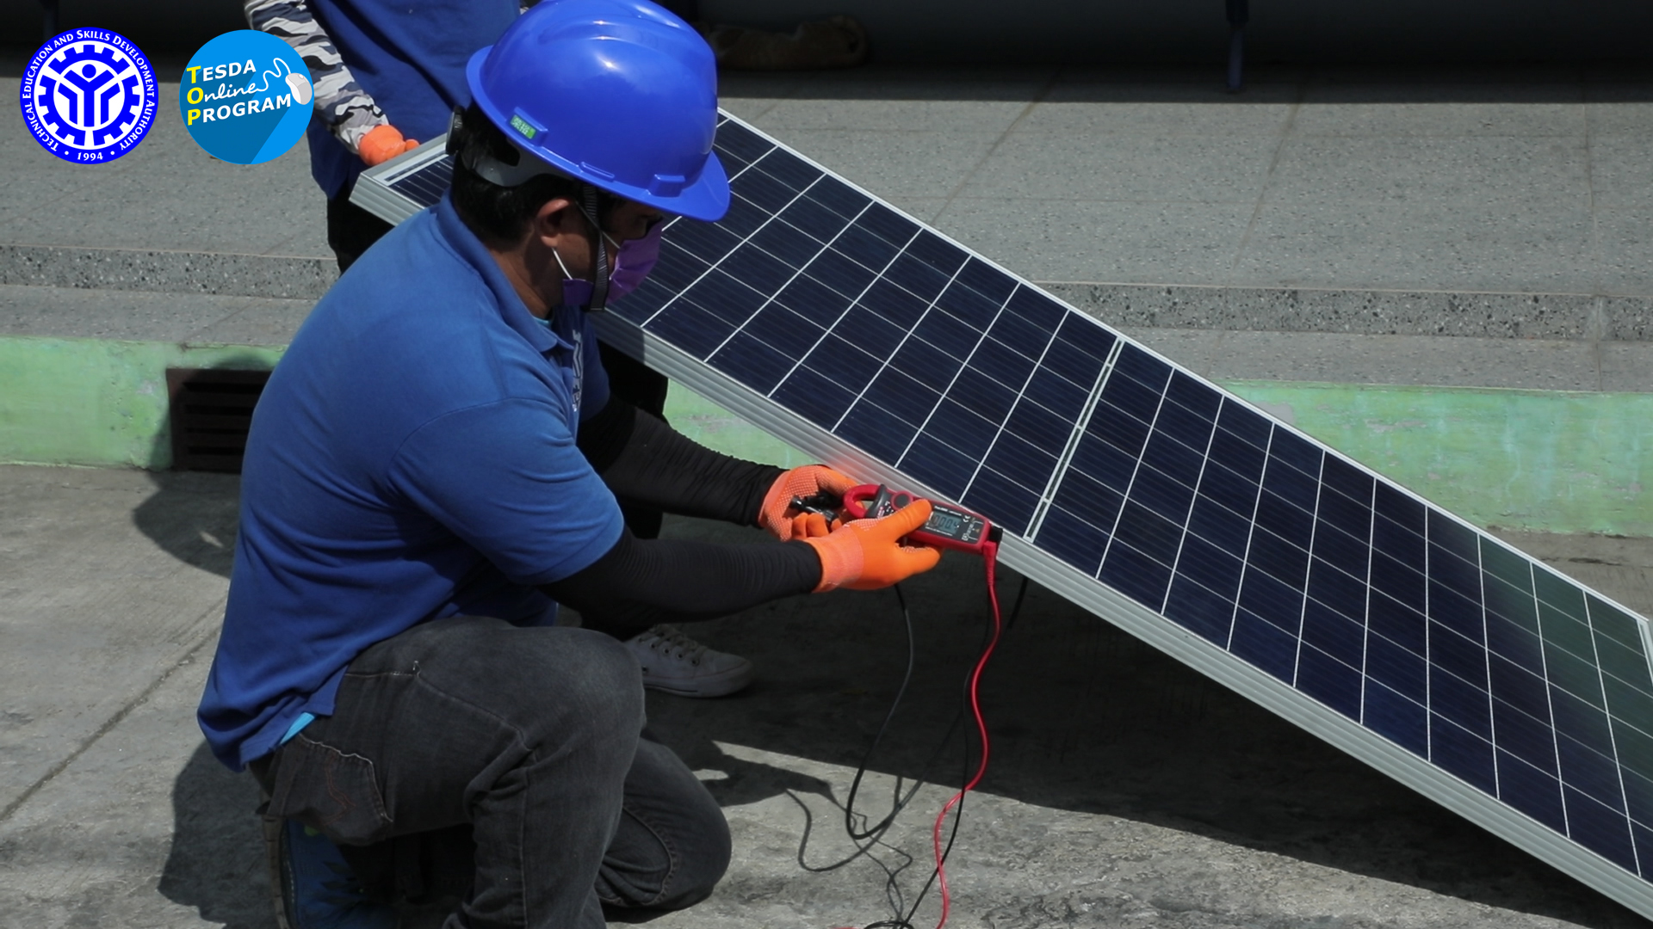
TESDA Direct and Indirect Costs
Training cost for the run of the PhotoVoltaic Systems Installation NC II of the TTIs through the technical assistance and support of eTESDA Division personnel and its existing facilities, equipment, and other resources of the Institute.
The training shall be funded by TESDA through the Training for Work Scholarship Program (TWSP).
Expected Outputs
Provision of an EdTech hardware package to the 4 TTs
Rural TTIs to utilize the blended learning in PhotoVoltaic Systems Installation NC II
Eight (8) batches of PhotoVoltaic Systems Installation NC II training conducted
Eight (8) M/E documentation (1 M/E documentation per batch); and
One (1) Pilot Project Report

Slide 43
Thank you!
For more information on the TIESEA project, visit our website:
www.tiesea.org

Slide 44
Assessment of EdTech Readiness & TIESEA Intervention
VIET NAM
Expert Forum – opportunities and risks for EdTech in Southeast Asia
(TIESEA project) 11th October 2022, BETT Asia, Bangkok

Slide 45
Brief country profile on education
Population (2022) | Over 99 M | Female 50.1%; Male 49.9%
K12 students | 17.6 M | Non-public: 4,8% = 845K students
Universities & vocational students | 1.7 M | 65/ 237 non-public universities
High-paid-on-education region | The South East region | 3.6X higher than other regions
GDP per capita (2021) | 3.759 USD
Government budget | 20% - 22% | 5% of GDP
Per student expenditure | 700 – 1000 USD | Gov $400 vs Family $300 Cities/ Provinces budgets (NA)
Family income spent on Education | ~ 40% | (only after food & shelter)
Notes:
All of the 4 country reports follow the same 5 pillar structure, and here is some findings in Vietnam.
•Population: almost reach 100M by May this year and ratio between male and female are almost equal.
•There are 17.6 K12 students and most of them are studying in public schools run by the government. Just less than 5% or nearly 850 thousand studying at International and private schools.
•Universities and vocational training students account for around 1.7M. We have 237 universities and again, most of them are public institutions, just 65 are private and international and most of them are located in 2 major cities - Hanoi & Hochiminh.
•In Vietnam, there are certain regions where payment for education is much higher than in other areas. For example, HCM standout with 3.6 times higher than any other city and province.
•The text highlighted in blue is the budget structure to pay for education in Vietnam, this one is more likely to apply for K12 education rather than universities and vocational schools
Some other points that may also interest our audiences
•First of all, The Vietnamese government’s regulations & policies on education in the last 20 years have been stable, and increased support for the cooperation between private and public sectors; and foreign investment in education are also very welcome.
•Increasing English-speaking young population allows easier delivery of Foreign education, especially digital content and e-learning or online classes.

Slide 46
Brief Insights
“Nice to have” vs “Must have” online education
90%: the penetration rate of learning devices
82% of Vietnamese students study online (WW - 67.5%)
High Internet connectivity rate (4G & 5G)
Fairly good digital skills (Teachers vs students)
Educational infrastructure is patchy, but smartphone penetration is high 90% of students in Vietnam used smartphones, PC, or laptops to study now High internet connectivity rate & fairly good digital skills in general 80% of Vietnamese students study online during Covid-19 outbreak Strong consumer market for education Most local startups use B2C sales models with free trial strategies The market is more willing to pay for online & offline hybrid learning solutions Business in Vietnam partly driven by relationships (formal & informal) Following Beijing’s constrains on education, Vietnam might become the next stop for foreign investments

Slide 47
5 Pillars
1
Infrastructure
2
Government
3
Schools and teachers
4
Home students and parents
5
EdTech providers
Notes:
So, overall, All 5 aspects investigated under TIESEA project indicate that Vietnam is in a good condition to transform and digitize the country’s education into a modern and sustainable system with the Government's strong support and guidance through some policies and regulations issued in recent years.

Slide 48
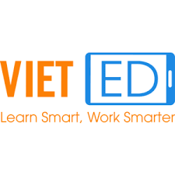
EdTech landscape Vietnam 2022
Kids – Early Childhood Education
K12
Students & Workforce
sunbot
…
…
…
Language
For enterprise
LMS, SAAS, Tool
Mentor & Venture & Agency
…
…
…
…
Notes:
Here is some of the top players in the local market. This ranking released by Edtech I Techfest in cooperation with Edtech Agency, November this year.
Currently, Vietnam is ranked as the top 10 world fastest growing EdTech markets.
And back to 2019, the total revenue already reached 1.4 billion USD and expected to reach 3B in 2023.
Up to now, over 600 edtech & elearning products & solutions have been introduced to the market. The most popular ones are SMS, LMS and CLS.
Most attractive target markets are LMS and content for K12, exam preparation, private tutoring & English language and upskills for working professional
However, none of those market sectors has yet dominated by any edtech company

Slide 49
Software
Elsa Speak
Teachers
Capacity to support learning with technology
Blended learning
(Mobile learning)
Students
EdTech Pilot Intervention
Improvement in listening, speaking, and communication skills in English.
Hardware
Smartphones
National
Curriculum
(Blended curriculum)
The potential to integrate the use of EdTech tools into the national curriculum
Notes:
My last slide focuses on the pilot intervention in Vietnam with the hope to tackle a long-term pain point in our traditional education.
The whole system has been struggling for a decade or more to improve English subject at public schools, particularly the ability to use the language to communicate effectively. That’s why we decided that the pilot will be testing the efficacy of EdTech support for improving English communicative language teaching and learning. The particular focus will be on K-12 students, especially in listening, speaking, and communication skills.
We will have a total of 300 students for both pilot and control schools from 4 different cities and provinces join the project. They will be provided with smartphones, Elsa speak application and 4G sim to get good access to the internet to practice at school and at home. The student improvement will be measured by an Ielt-Standart based exam conducted at the beginning and the end of the pilot program.
All teachers in both control and pilot schools will be trained to use modern communicative language teaching methodologies. The training program will be provided by the University of Languages & International Studies. The teachers will also be provided with Laptops, 4G sim cards to get good access to the Internet, especially to the teacher dashboard provided by Elsa to track student learning outcomes every week.
The pilot schools will use a blended learning approach whereby in-class sessions are reinforced through student self-study. Google workspace for education will be installed for all pilot schools to control the students’ smartphones and the students’ activities on the device since they will be allowed to bring smartphones home for self-study.
Project impact will be assessed in 4 aspects:
·Firstly, student learning outcomes: improvement in their listening, speaking, and communication skills in English compared to their peers in similar schools operating outside the project. Achievement will be measured using the IELTS criteria.
·Secondly, Teacher capacity to support learning with technology: digital skills and application of technology to enhance classroom practice.
·Thirdly, the potential to integrate the use of EdTech tools into the national curriculum.
·Last but not least, Demonstrate the effectiveness of smartphones to create an enhanced learning environment with appropriate safeguards for students under the monitoring and management of schools and teachers.
The Tiesea team expects that the pilot project will contribute a good sample of the use of EdTech for teaching and learning, and at the same time to create an EdTech roadmap for Viet Nam based on the key findings of the project.

Slide 50
Thank you!
For more information on the TIESEA project, visit our website:
www.tiesea.org

